Slide 1
AWS THREE-TIER WEB ARCHITUCTURE
by Akash Gowda

Slide 2
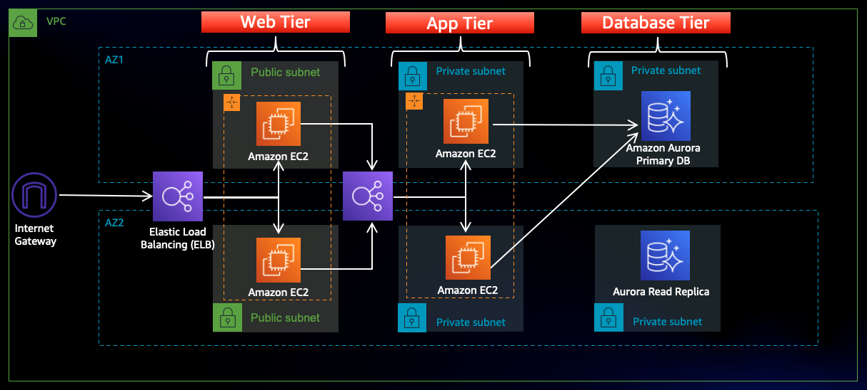
ARCHITECTURE OVERVIEW

Slide 3
Architecture designing is divided into multiple parts in order to ensure the smooth flow of the same
The setup
Networking and security
Database deployment
App tier instance deployment
Internal load balancing and auto scaling
Web tier instance deployment
External load balancer and auto scaling

Slide 4
1.The setup
Download Code from Github Repository
S3 Bucket Creation
IAM EC2 Instance Role Creation

Slide 5
Download Code from Github
https://github.com/aws-samples/aws-three-tier-web-architecture-workshop
Download the zip file from the above link or
git clone https://github.com/aws-samples/aws-three-tier-web-architecture-workshop.git
Run the above command in your git

Slide 6
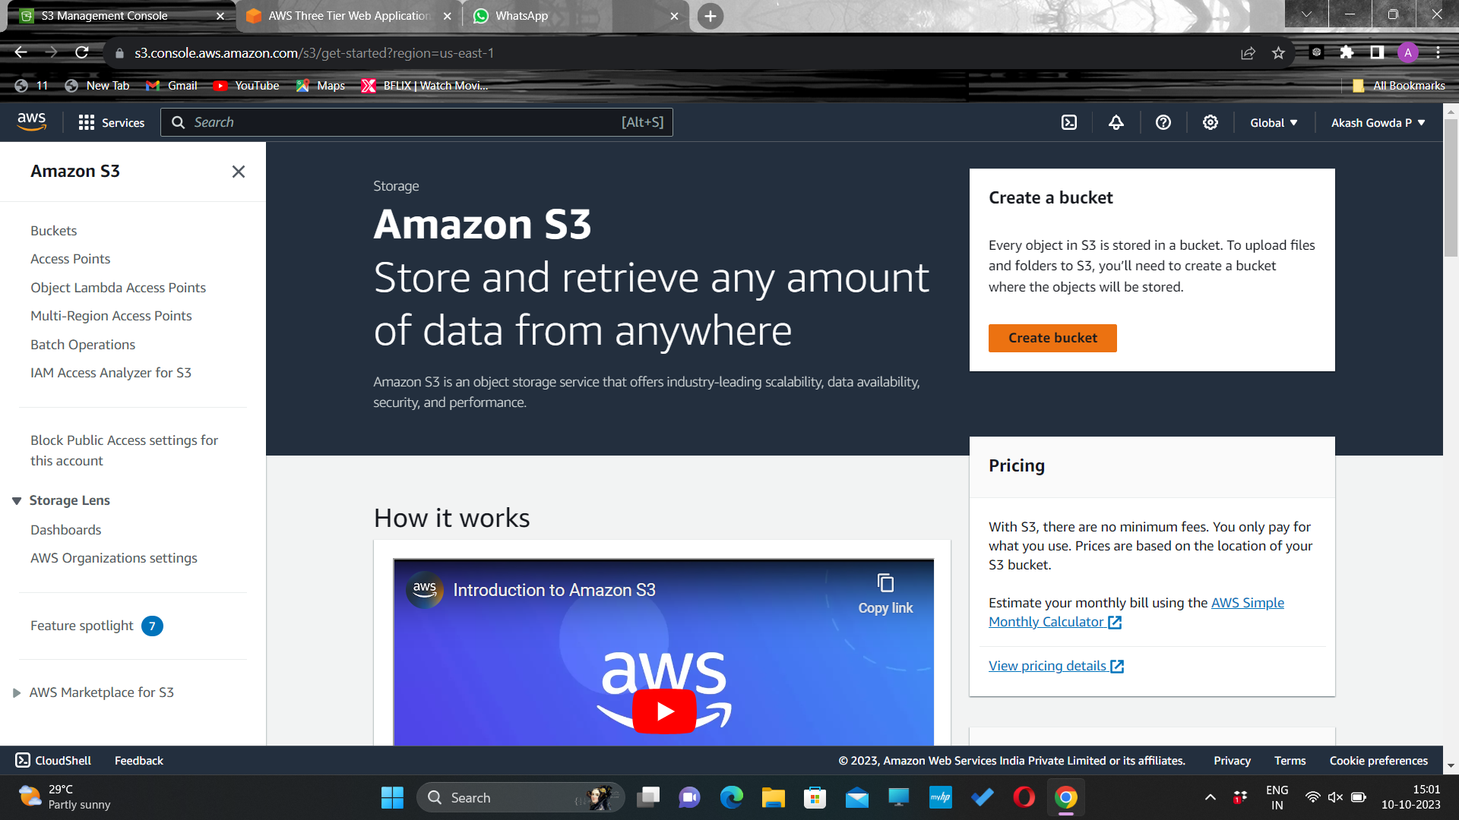
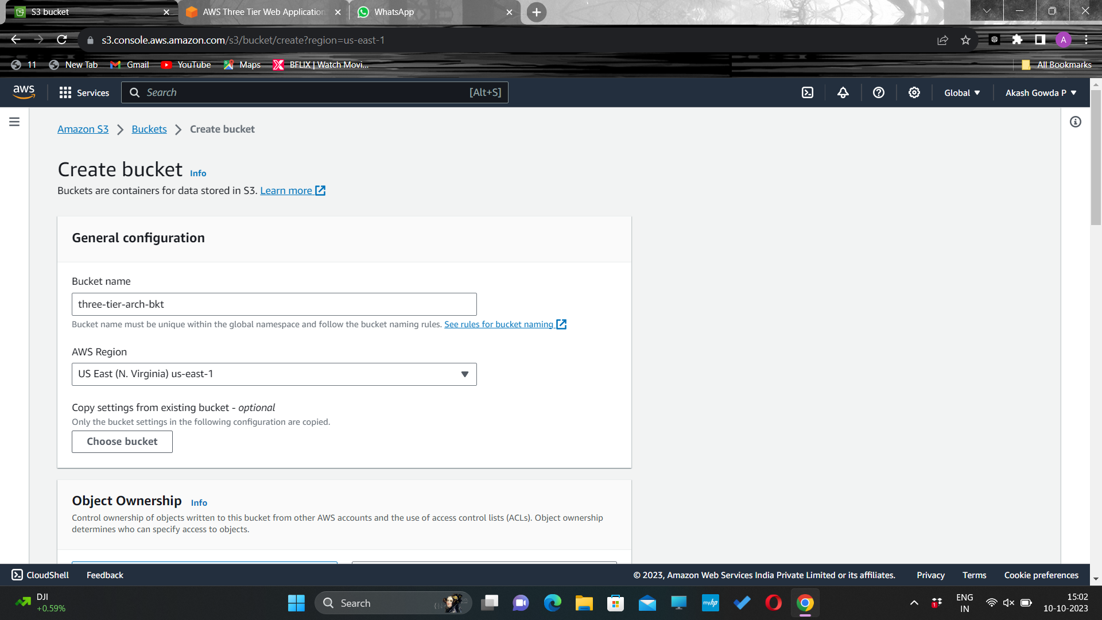
S3 Bucket Creation
S3 Bucket Creation
Navigate to the S3 service in the AWS console and create a new S3 bucket.
Give it a unique name, and then leave all the defaults as in.

Slide 7
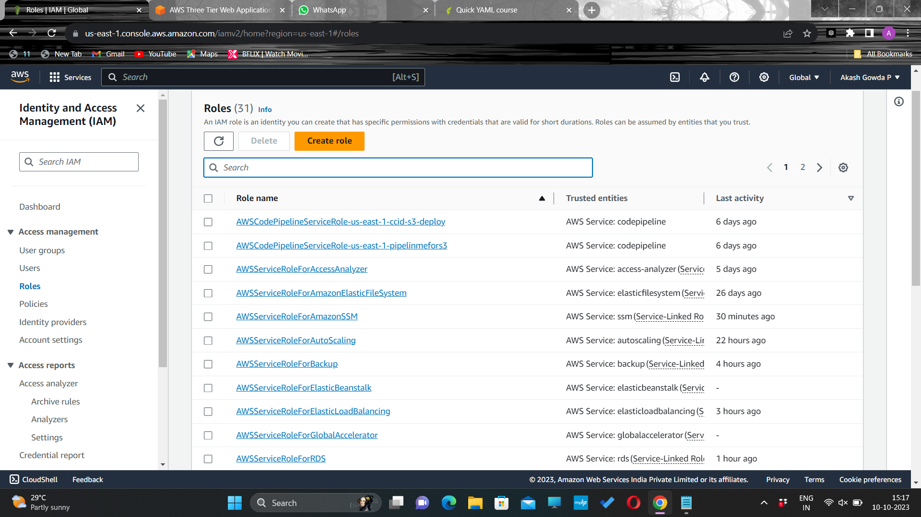
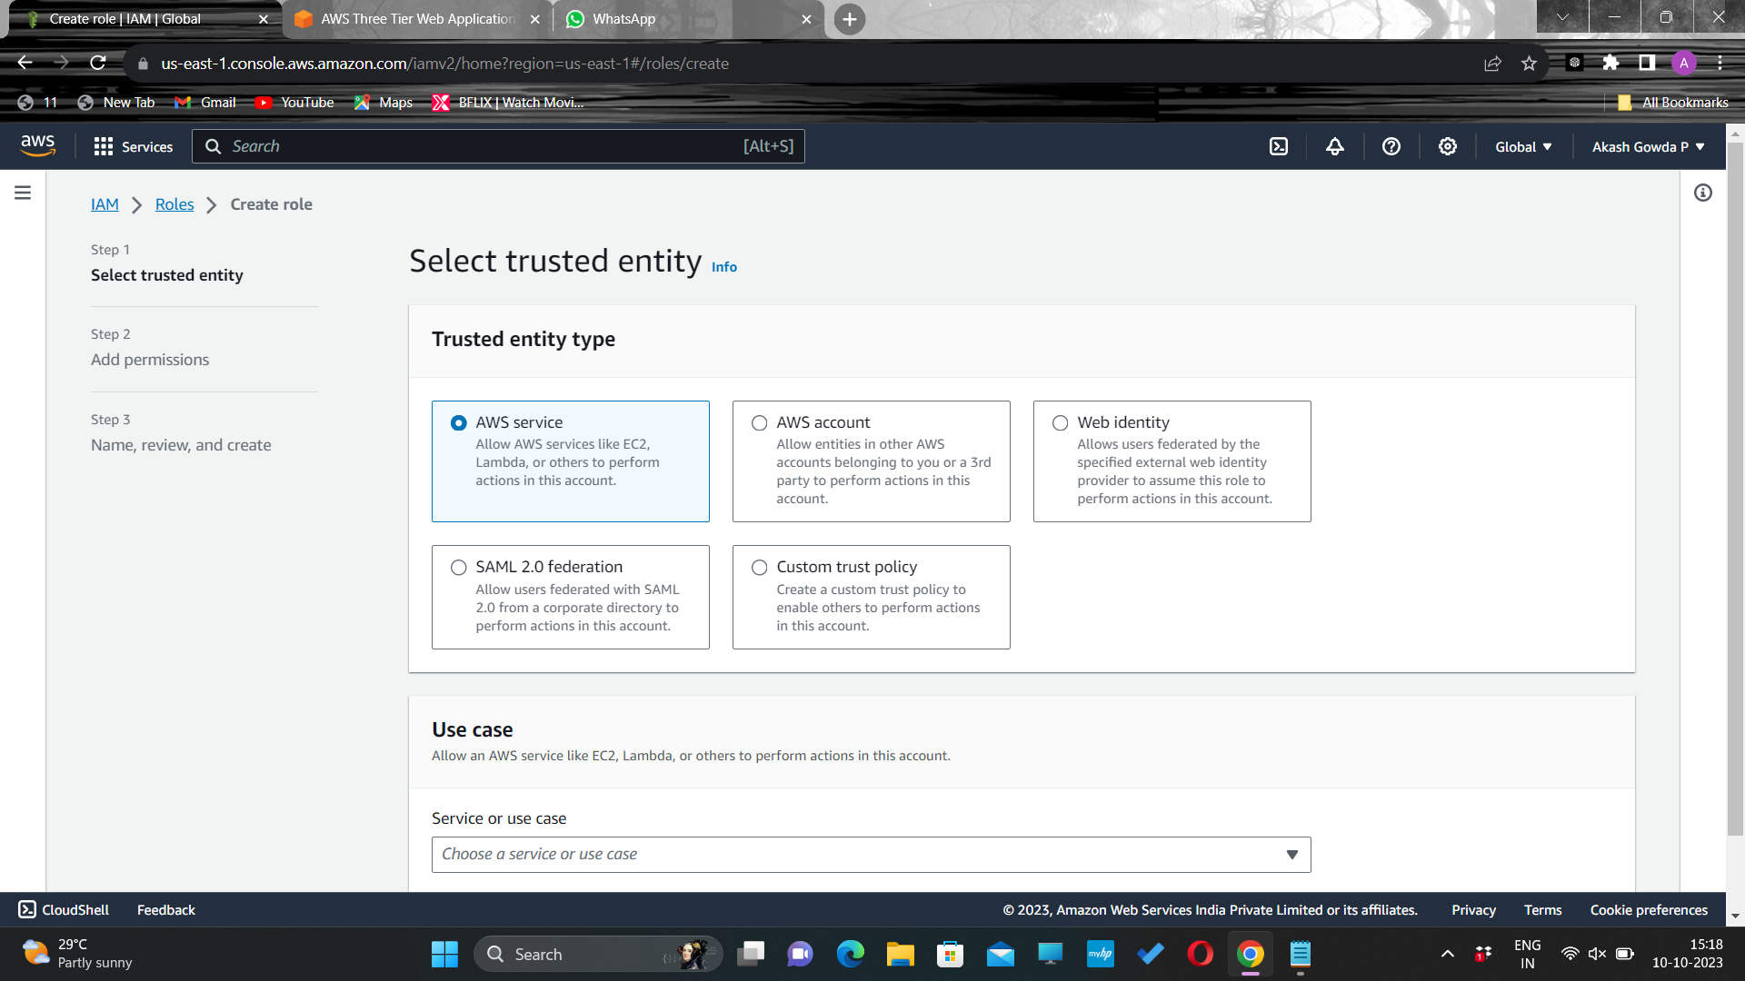
IAM EC2 Instance Role Creation
Navigate to the IAM dashboard in the AWS console and create an EC2 role.
Select AWS service and scroll down.

Slide 8
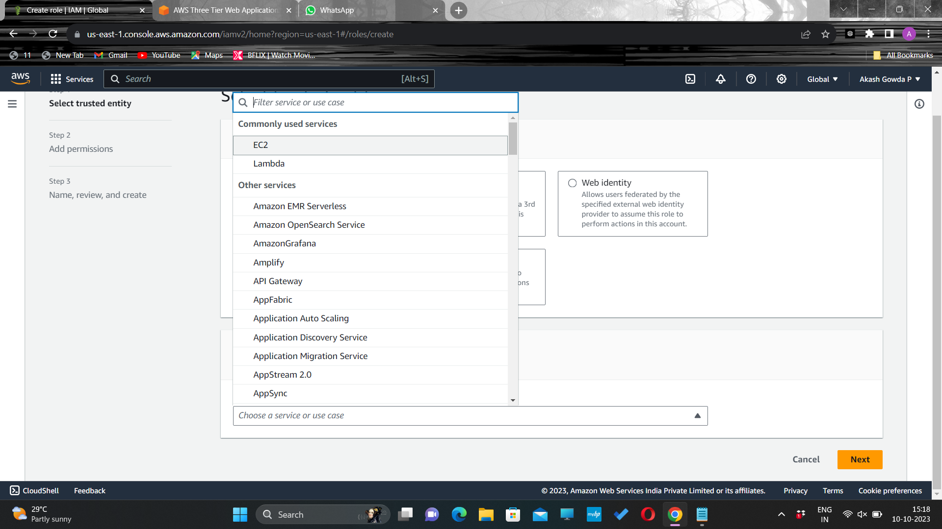
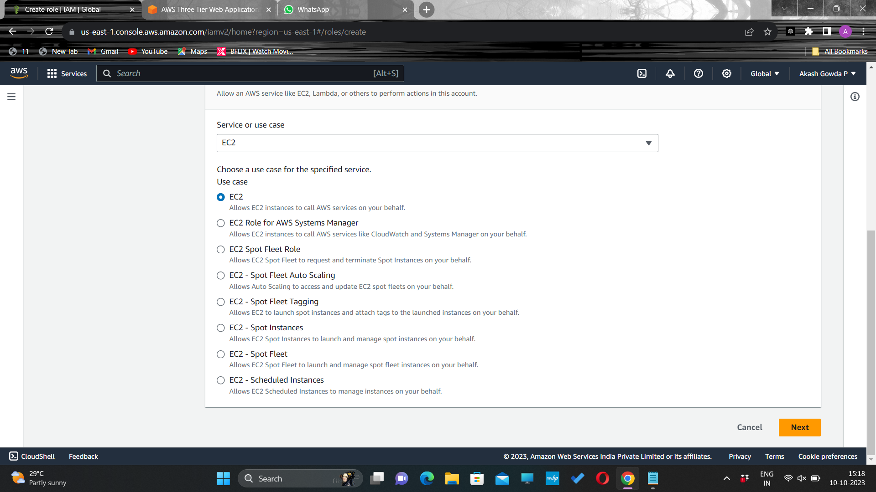
Select EC2 as the trusted entity

Slide 9
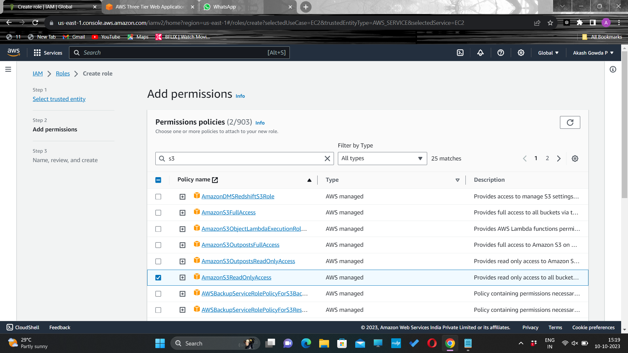
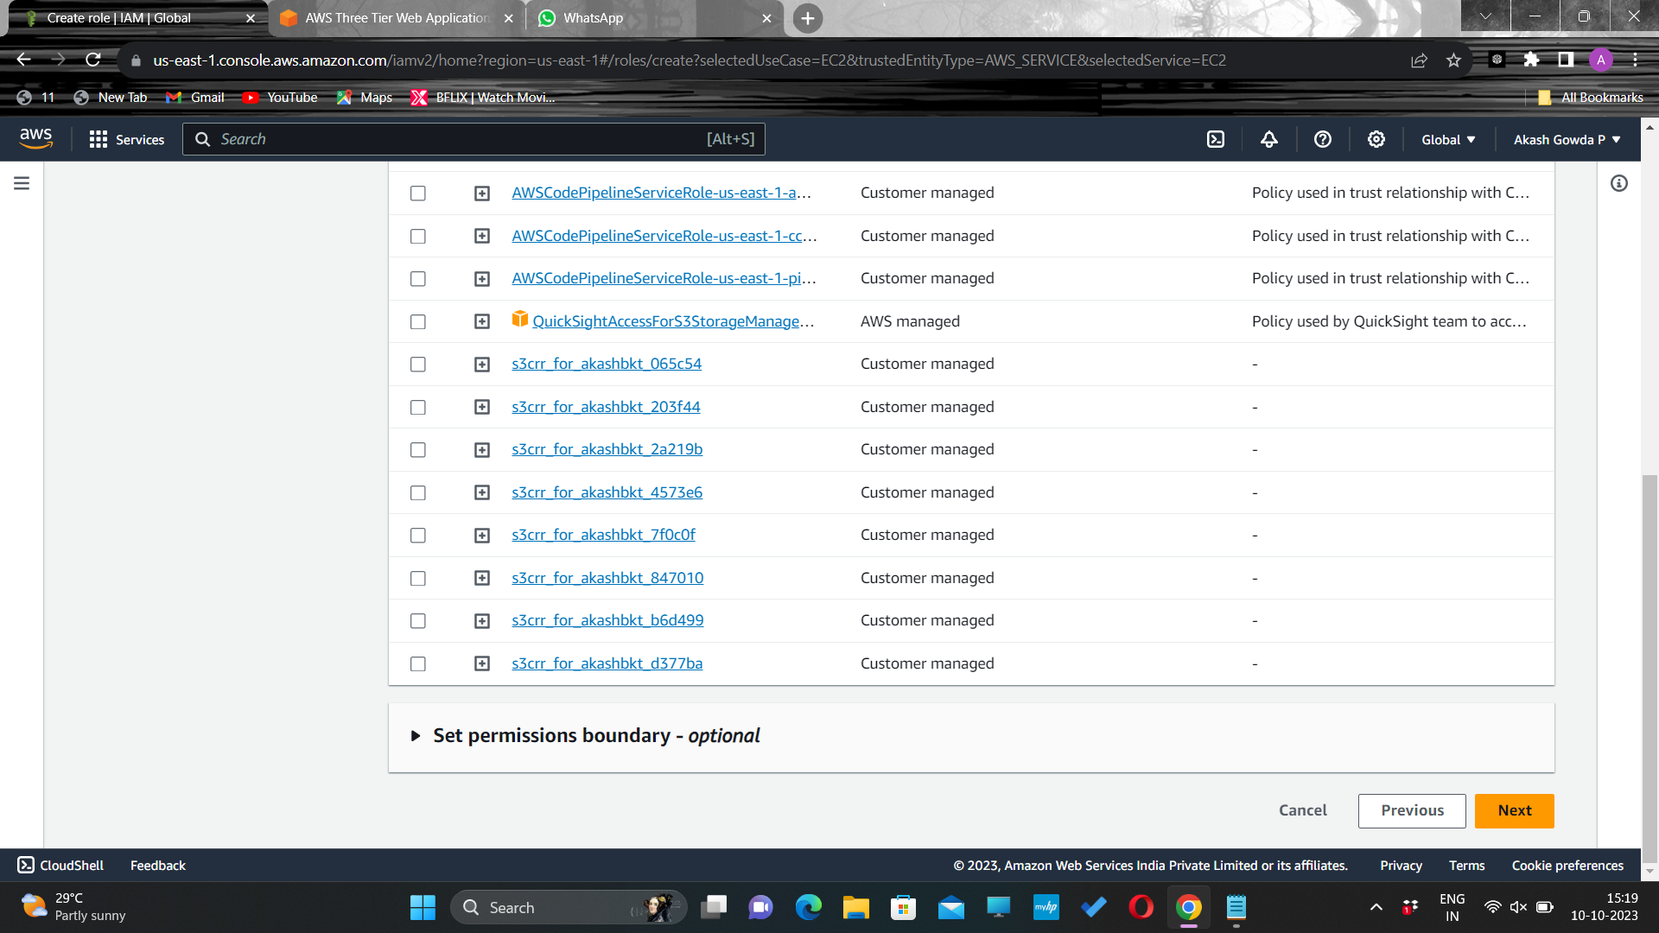

When adding permissions, include the following AWS managed policies.
AmazonS3ReadOnlyAccess
AmazonSSMManagedInstanceCore
These policies will allow our instances to download our code from S3 and use Systems Manager Session Manager to securely connect to our instances without SSH keys through the AWS console.

Slide 10
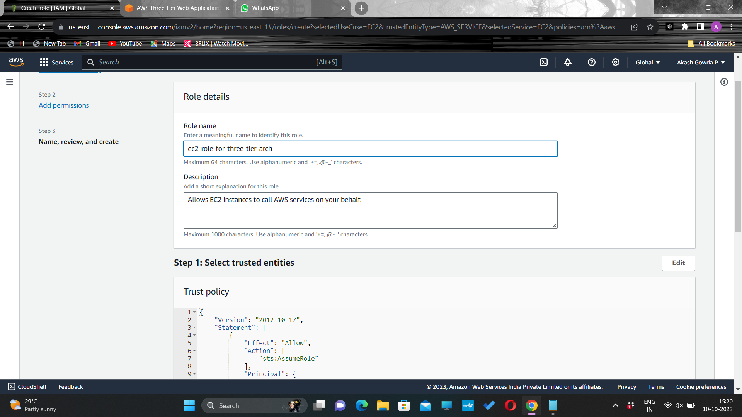
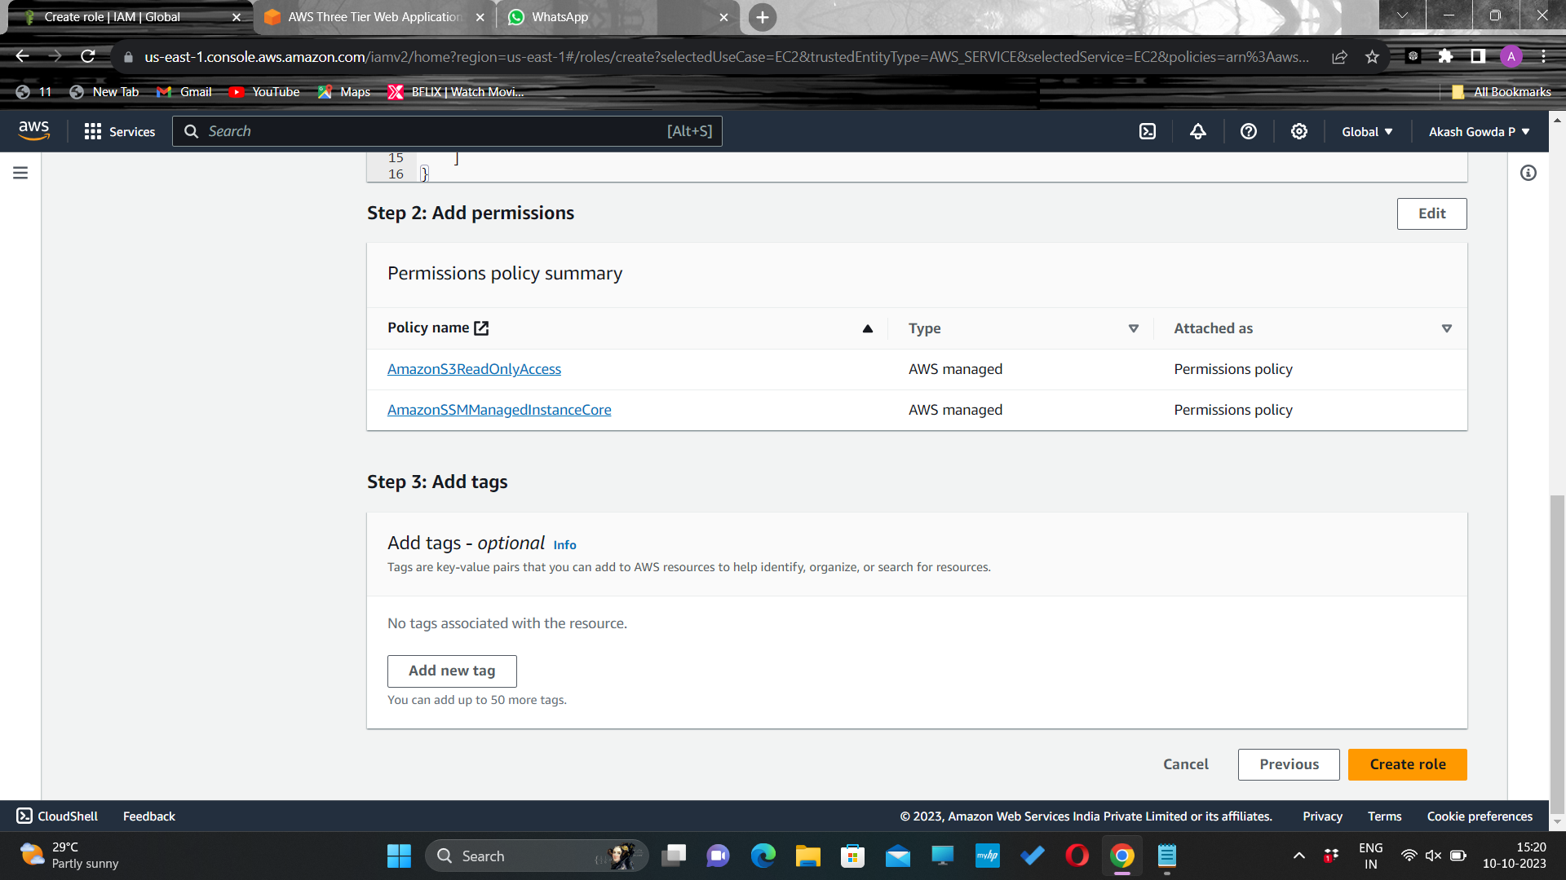
Give a name to the role, and then click Create Role.

Slide 11
2. Networking and Security
Create an isolated network with the following components:
VPC
Subnets
Route Tables
Internet Gateway
NAT gateway
Security Groups

Slide 12
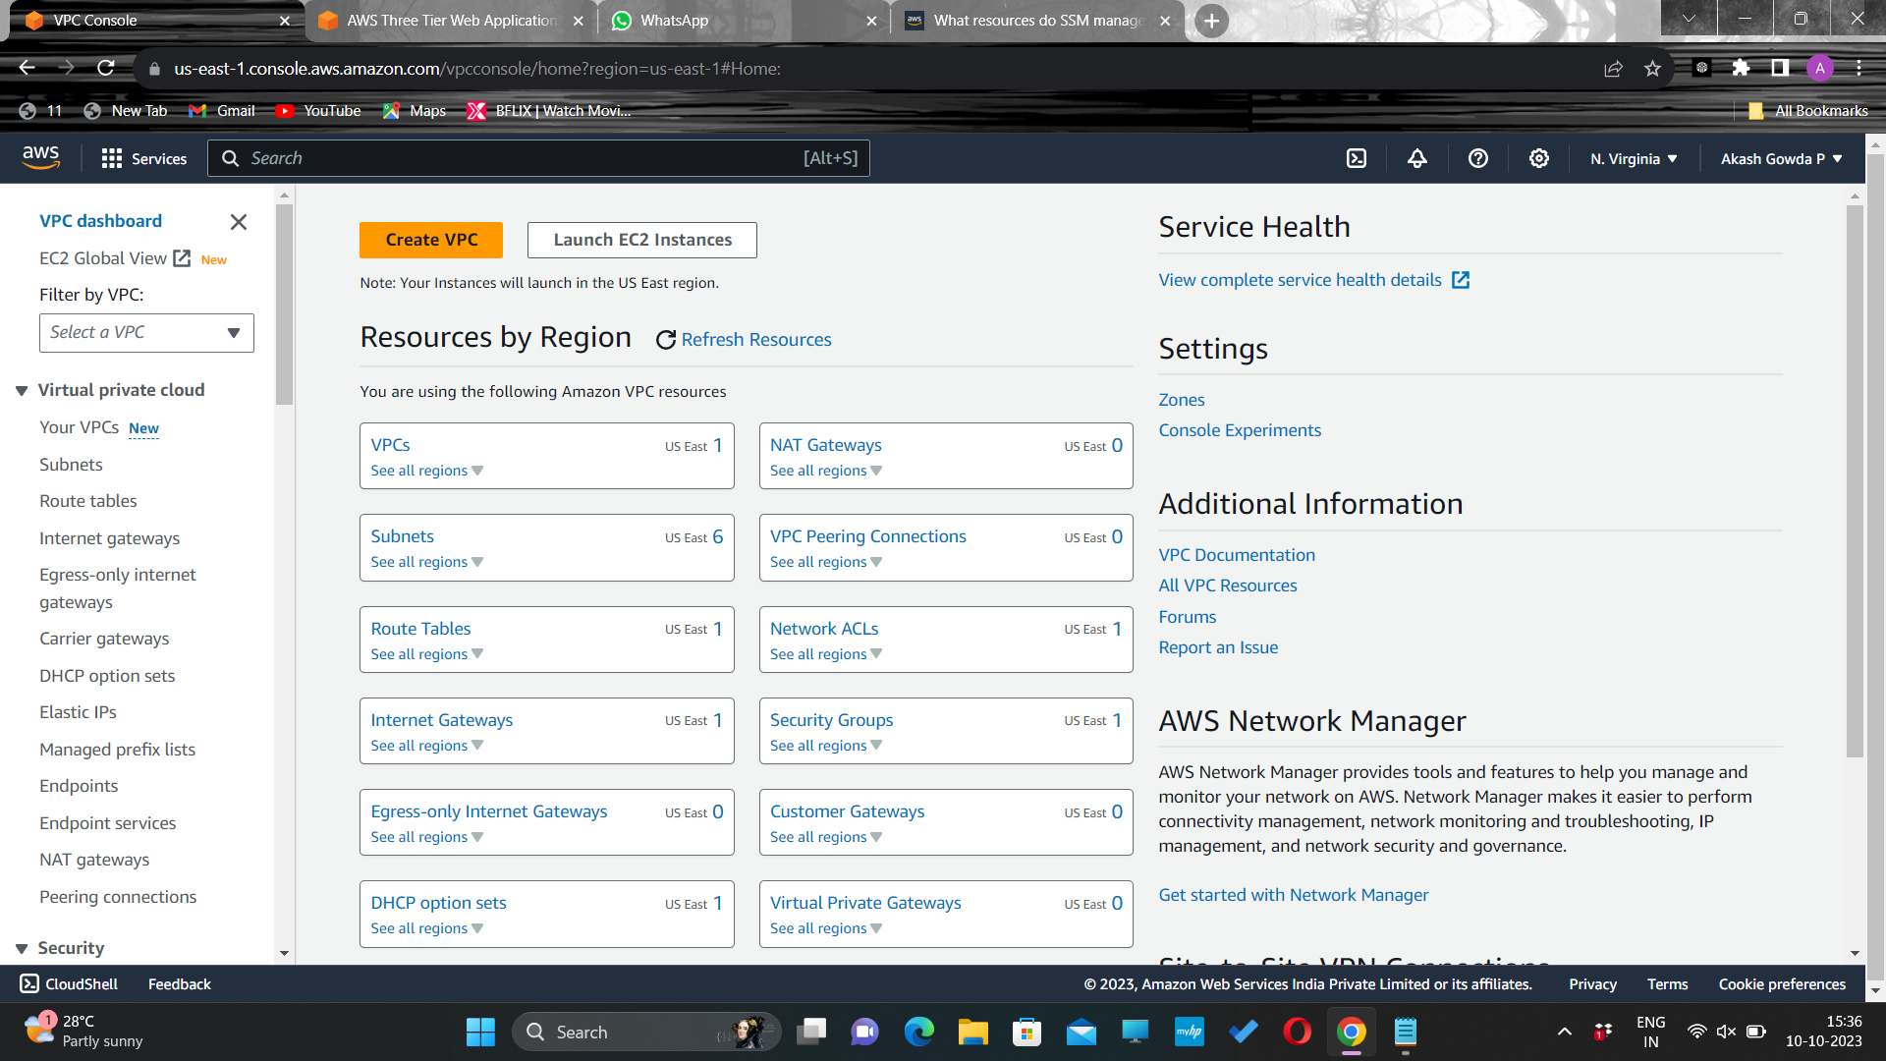
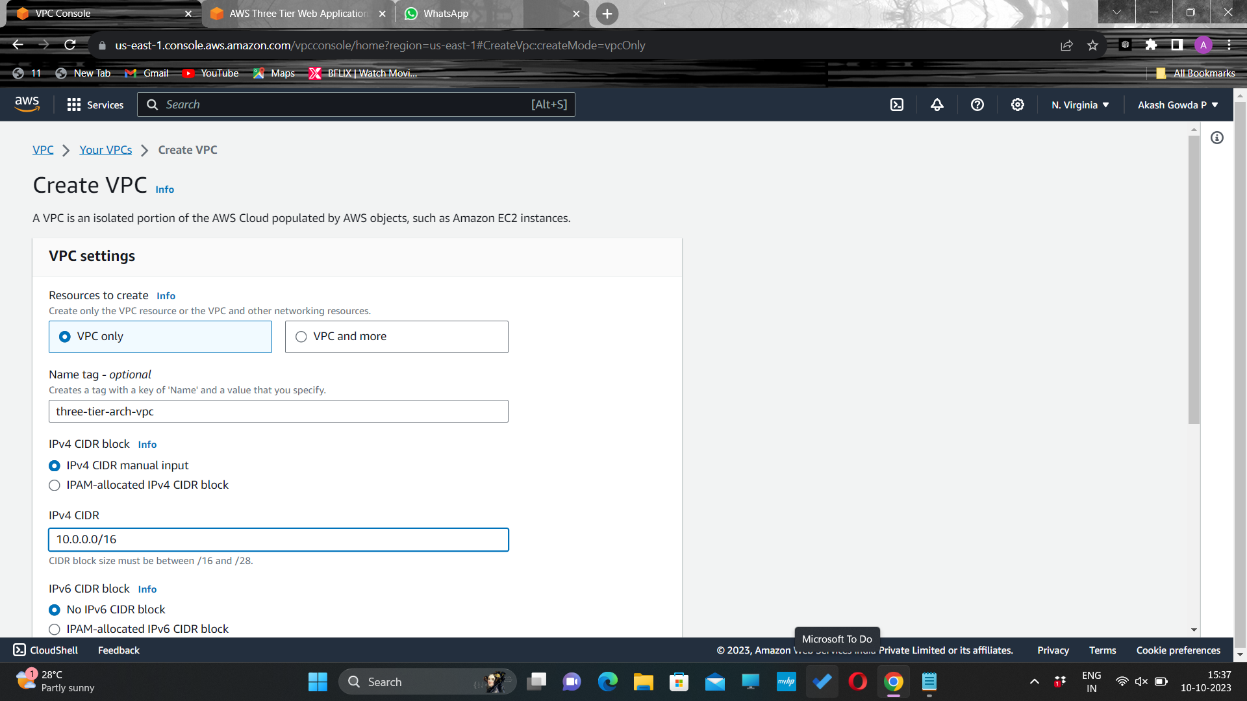
VPC Creation
Navigate to the VPC dashboard in the AWS console and navigate to Your VPCs on the left hand side.
Make sure VPC only is selected, and fill out the VPC Settings with a Name tag

Slide 13
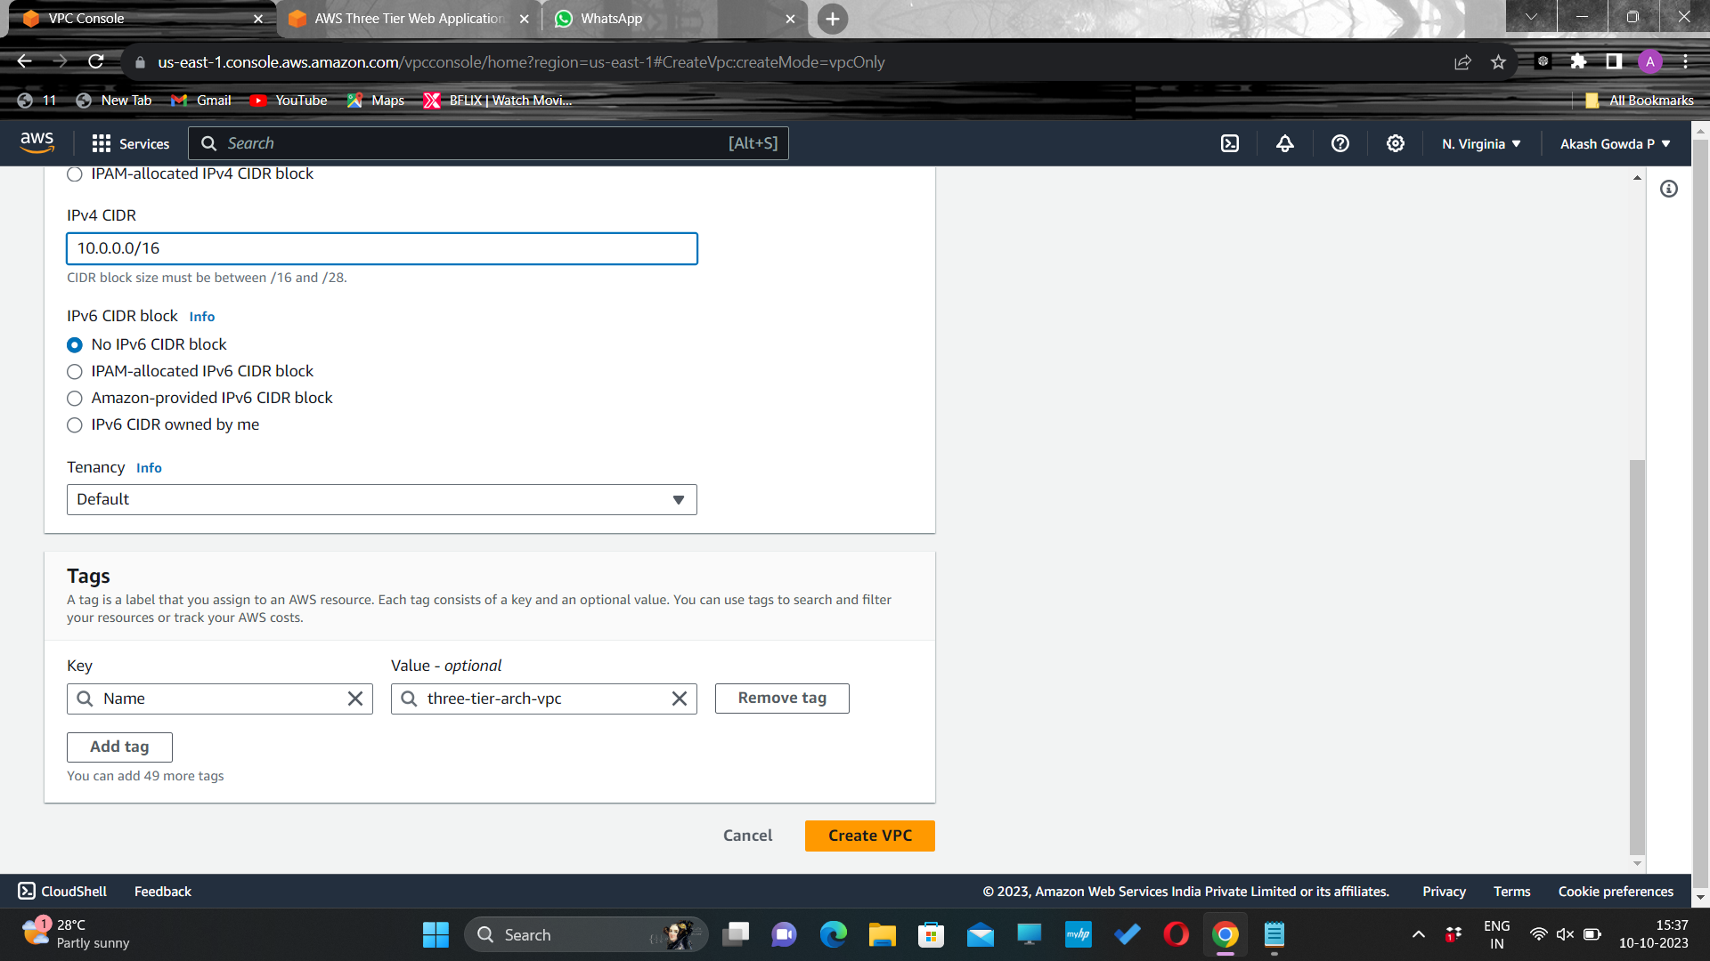
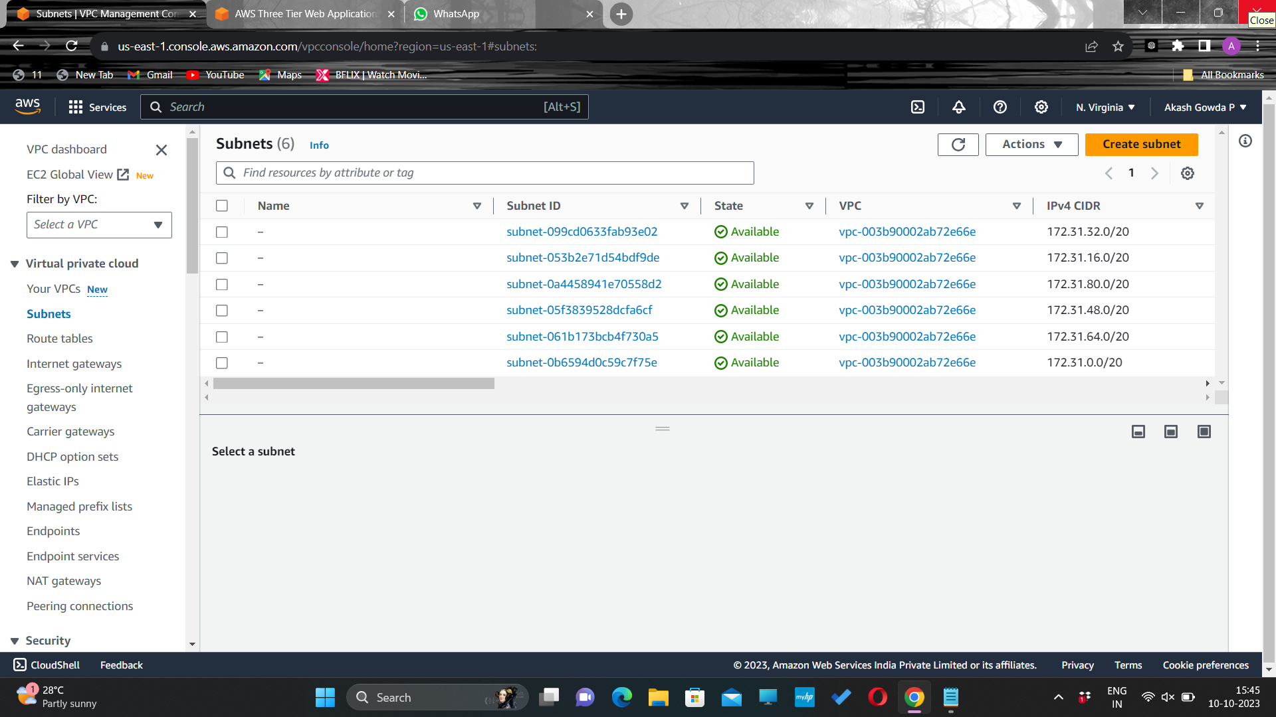
Subnet Creation
Choose the CIDR range and make sure to keep the tenancy in Default.
Next, create your subnets by navigating to Subnets on the left side of the dashboard and clicking Create subnet.

Slide 14
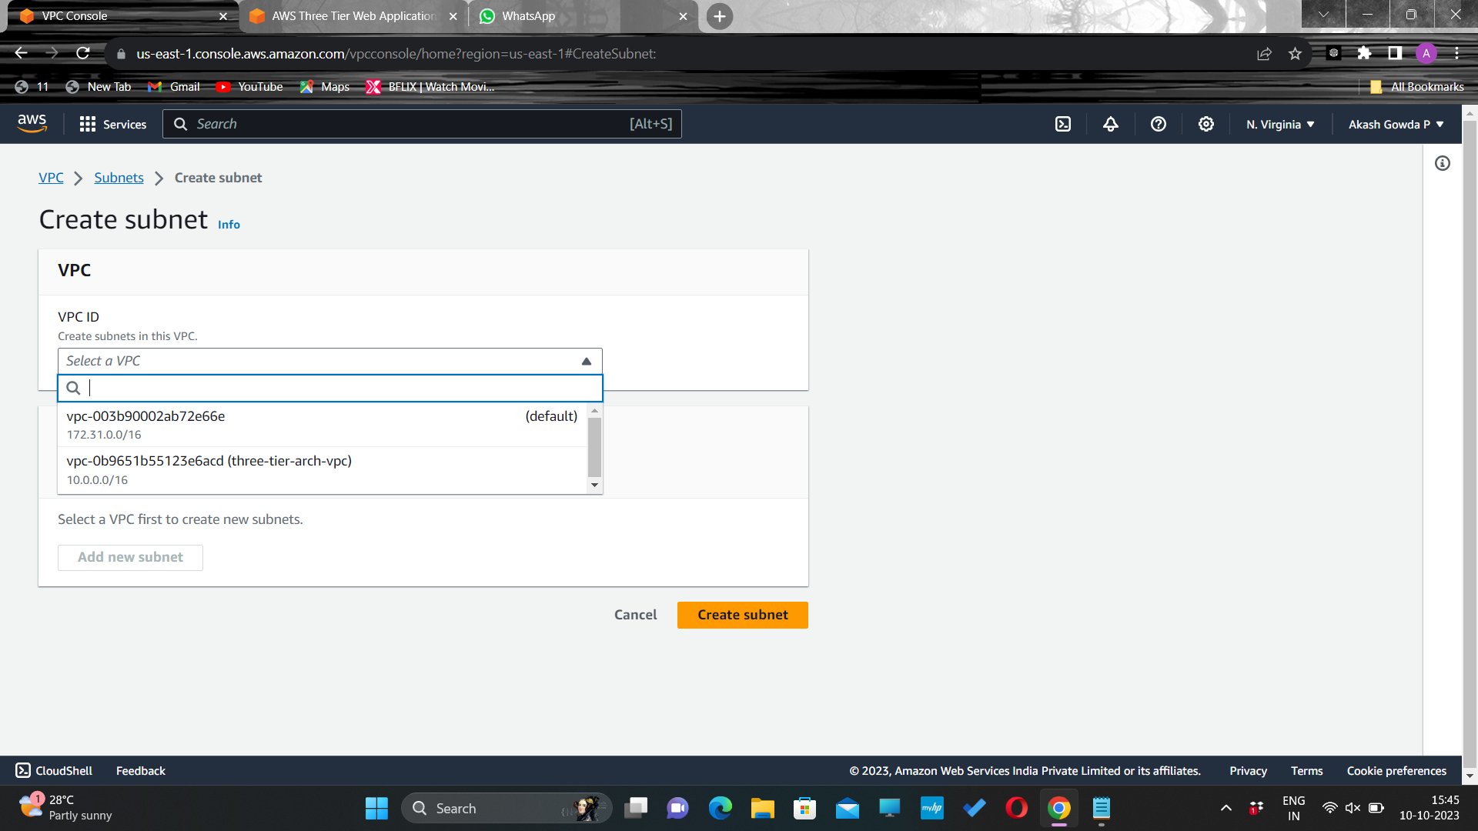
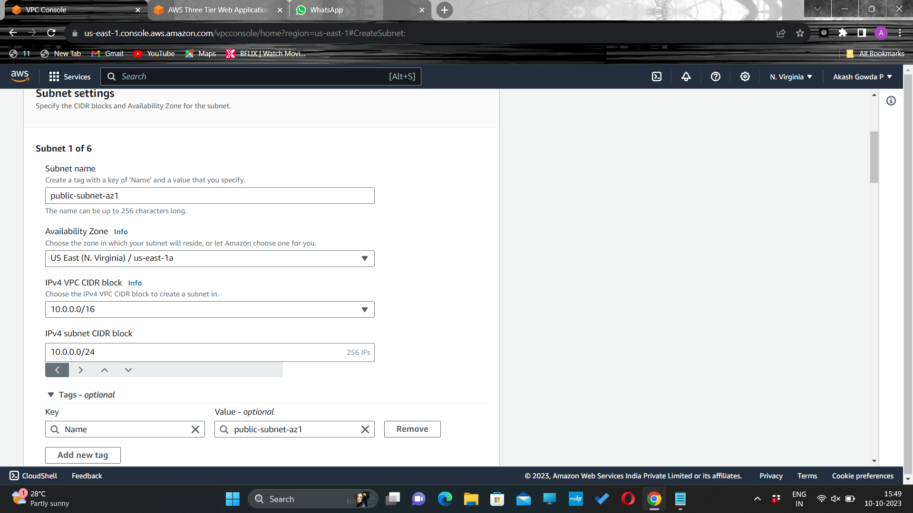
We will need six subnets across two availability zones. That means that three subnets will be in one availability zone, and three subnets will be in another zone. Each subnet in one availability zone will correspond to one layer of our three tier architecture. Create each of the 6 subnets by specifying the VPC we created in part 1 and then choose a name, availability zone, and appropriate CIDR range for each of the subnets.
Select the VPC we created and click on Create subnet
Public subnet-az1

Slide 15


Public subnet-az2
Private subnet-az1

Slide 16


Public subnet-az2
Database subnet-az1

Slide 17
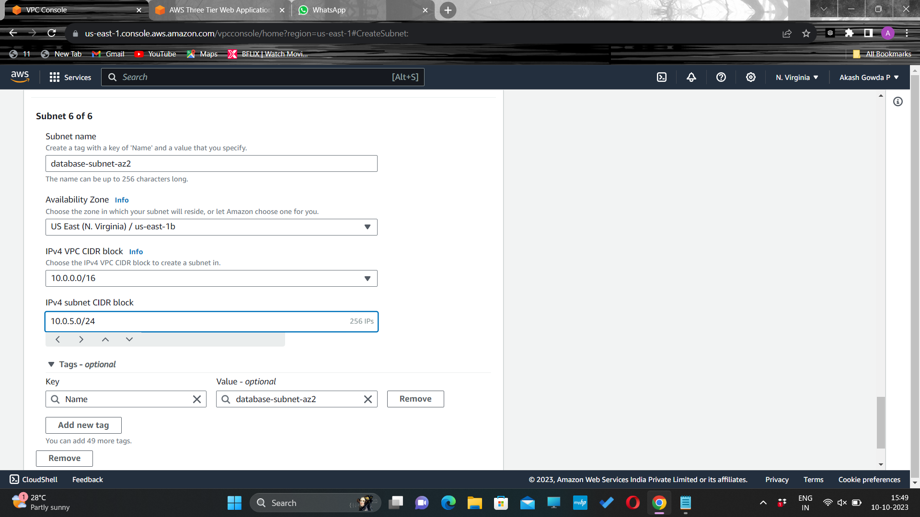
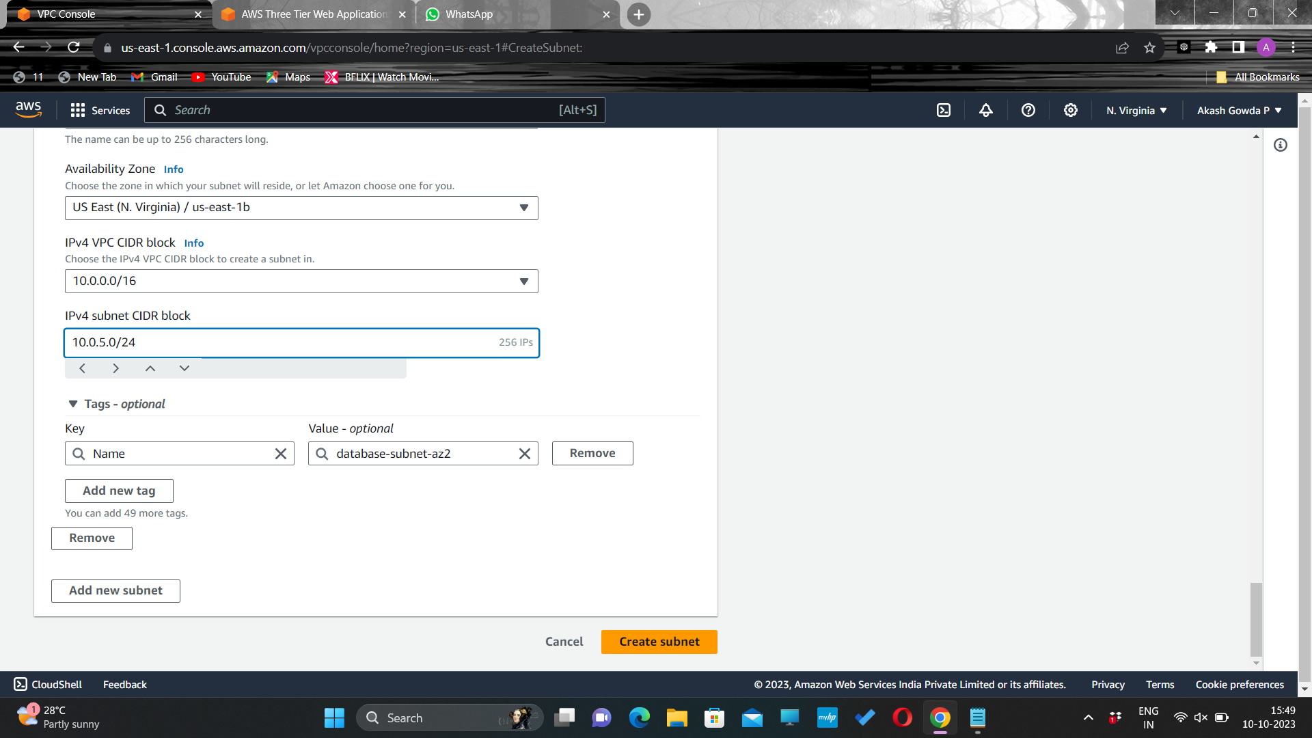
Database subnet-az1
Create subnet

Slide 18
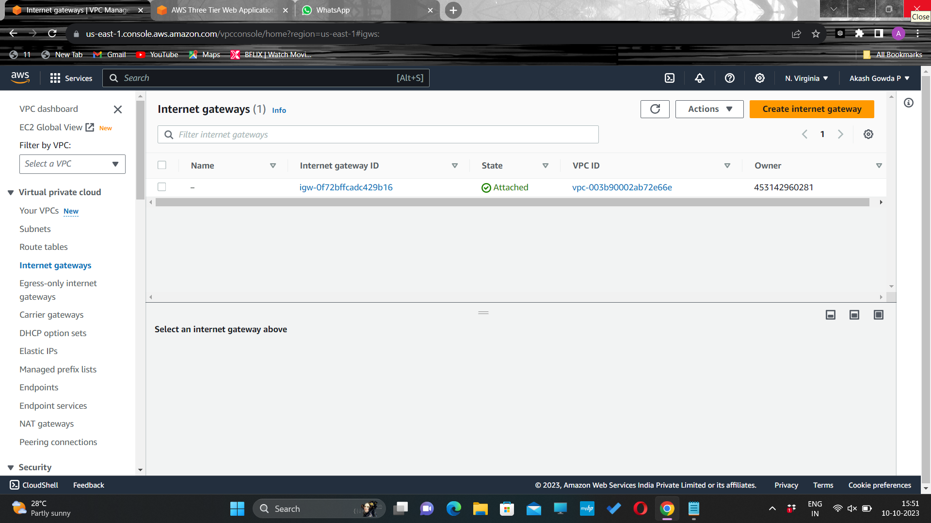
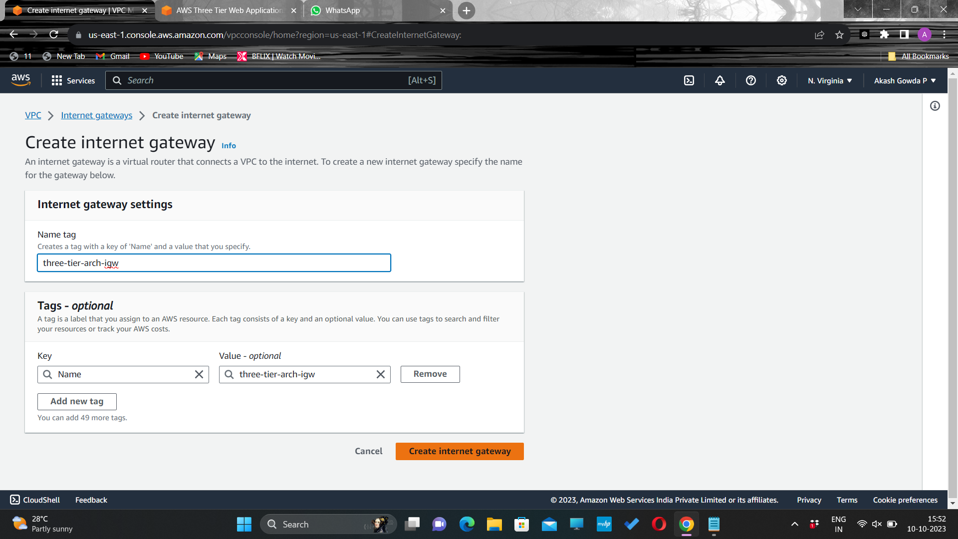
Internet Gateway
In order to give the public subnets in our VPC internet access we will have to create and attach an Internet Gateway. On the left hand side of the VPC dashboard, select Internet Gateway.
Create your internet gateway by simply giving it a name and clicking Create internet gateway.

Slide 19
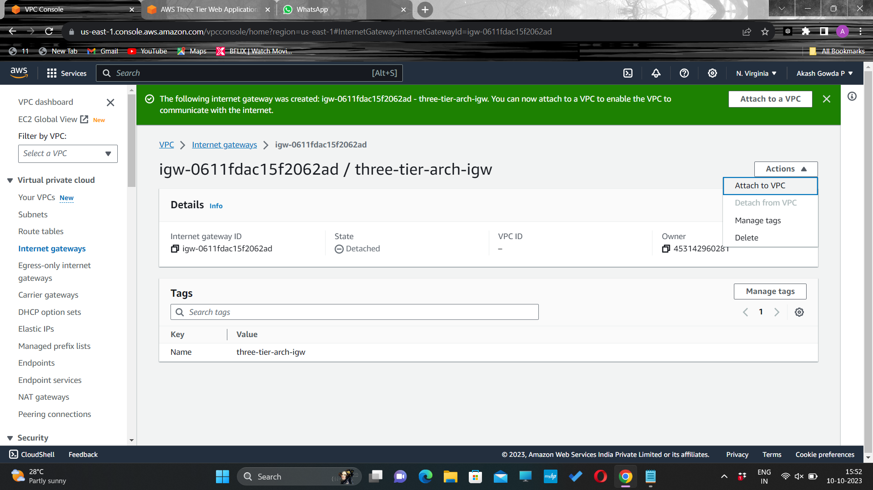
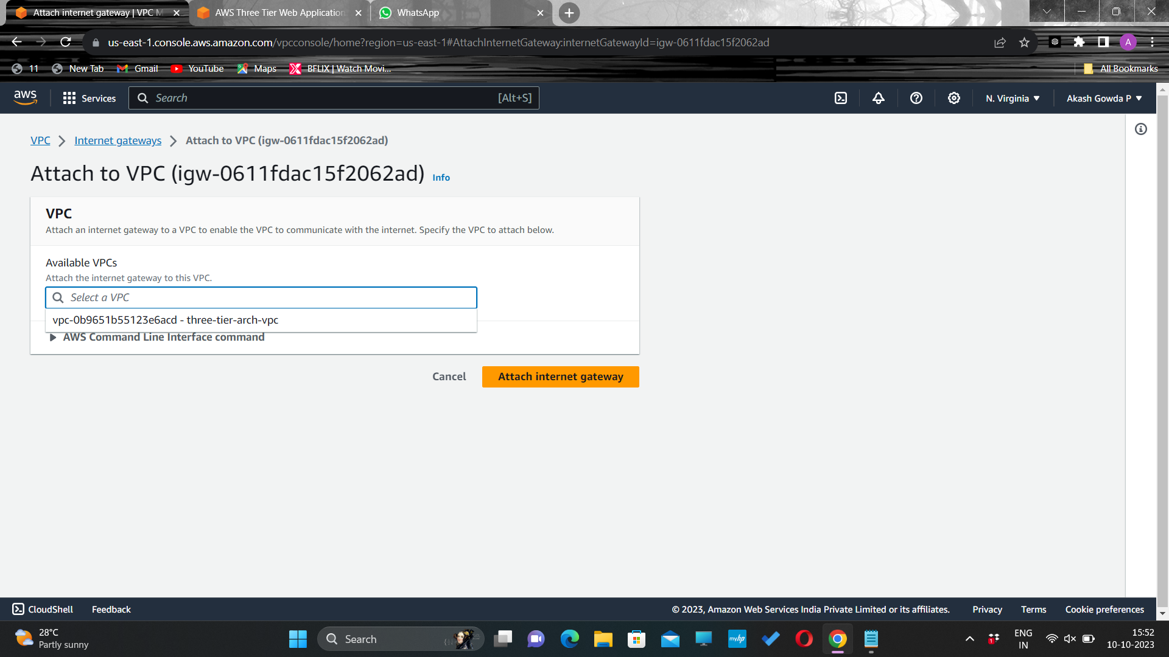
Attach it to your VPC through Actions drop down.
Select the correct VPC and click Attach internet gateway.

Slide 20
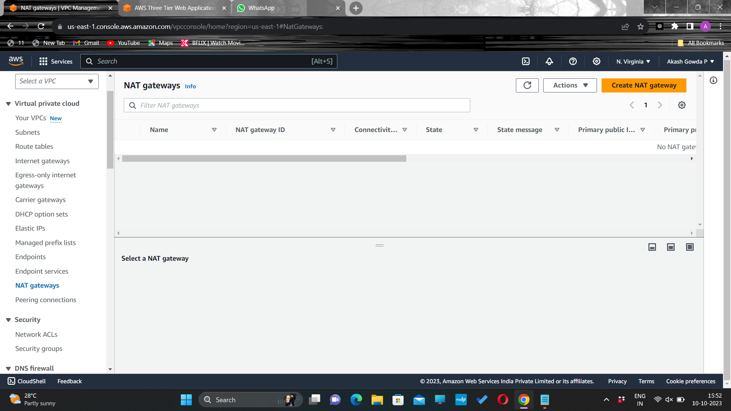
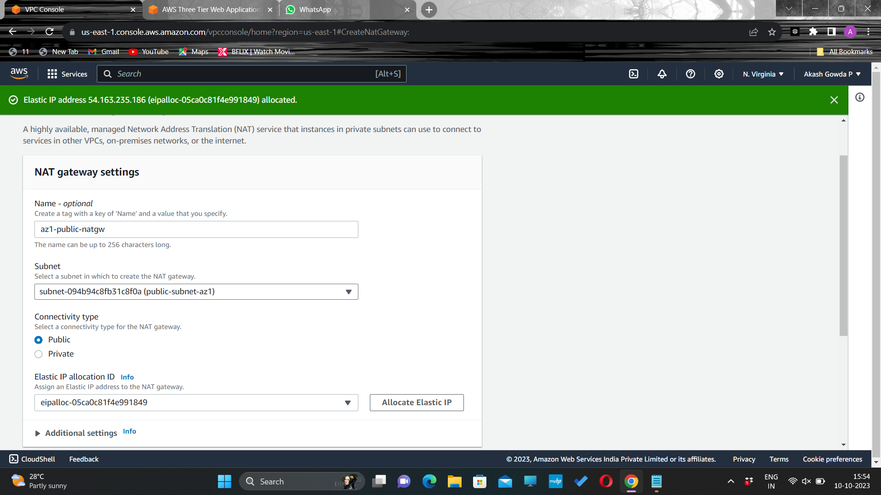
NAT Gateway
Navigate to NAT Gateways on the left side of the current dashboard and click Create NAT Gateway.
Fill in the Name, choose one of the public subnets we created , and then allocate an Elastic IP

Slide 21
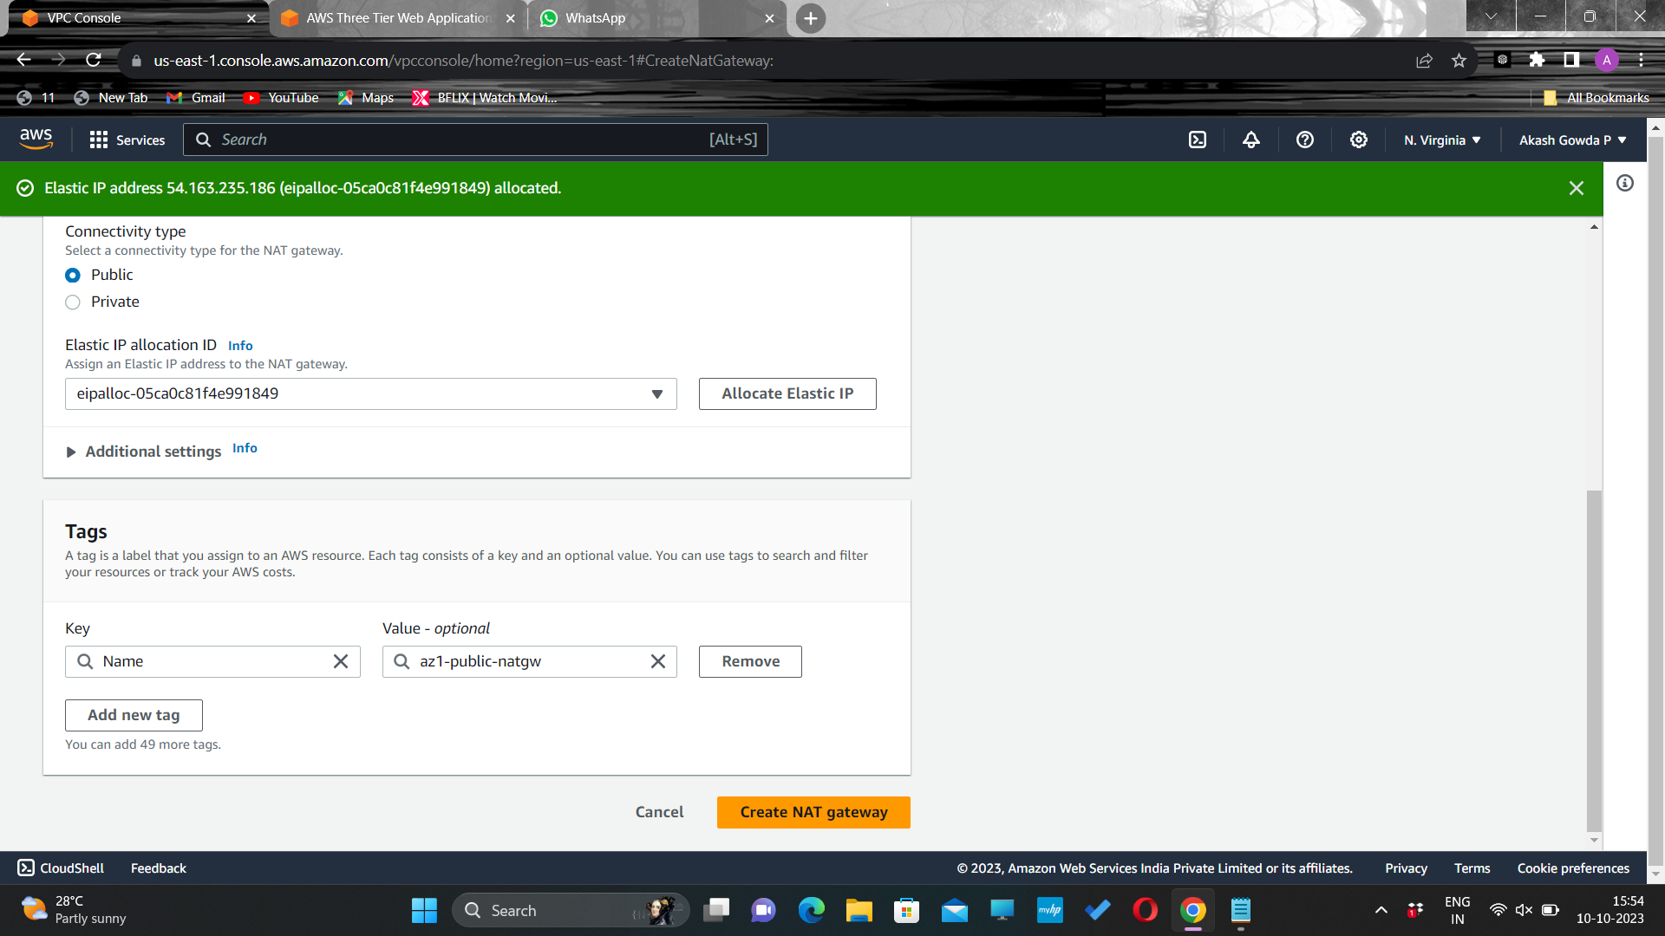
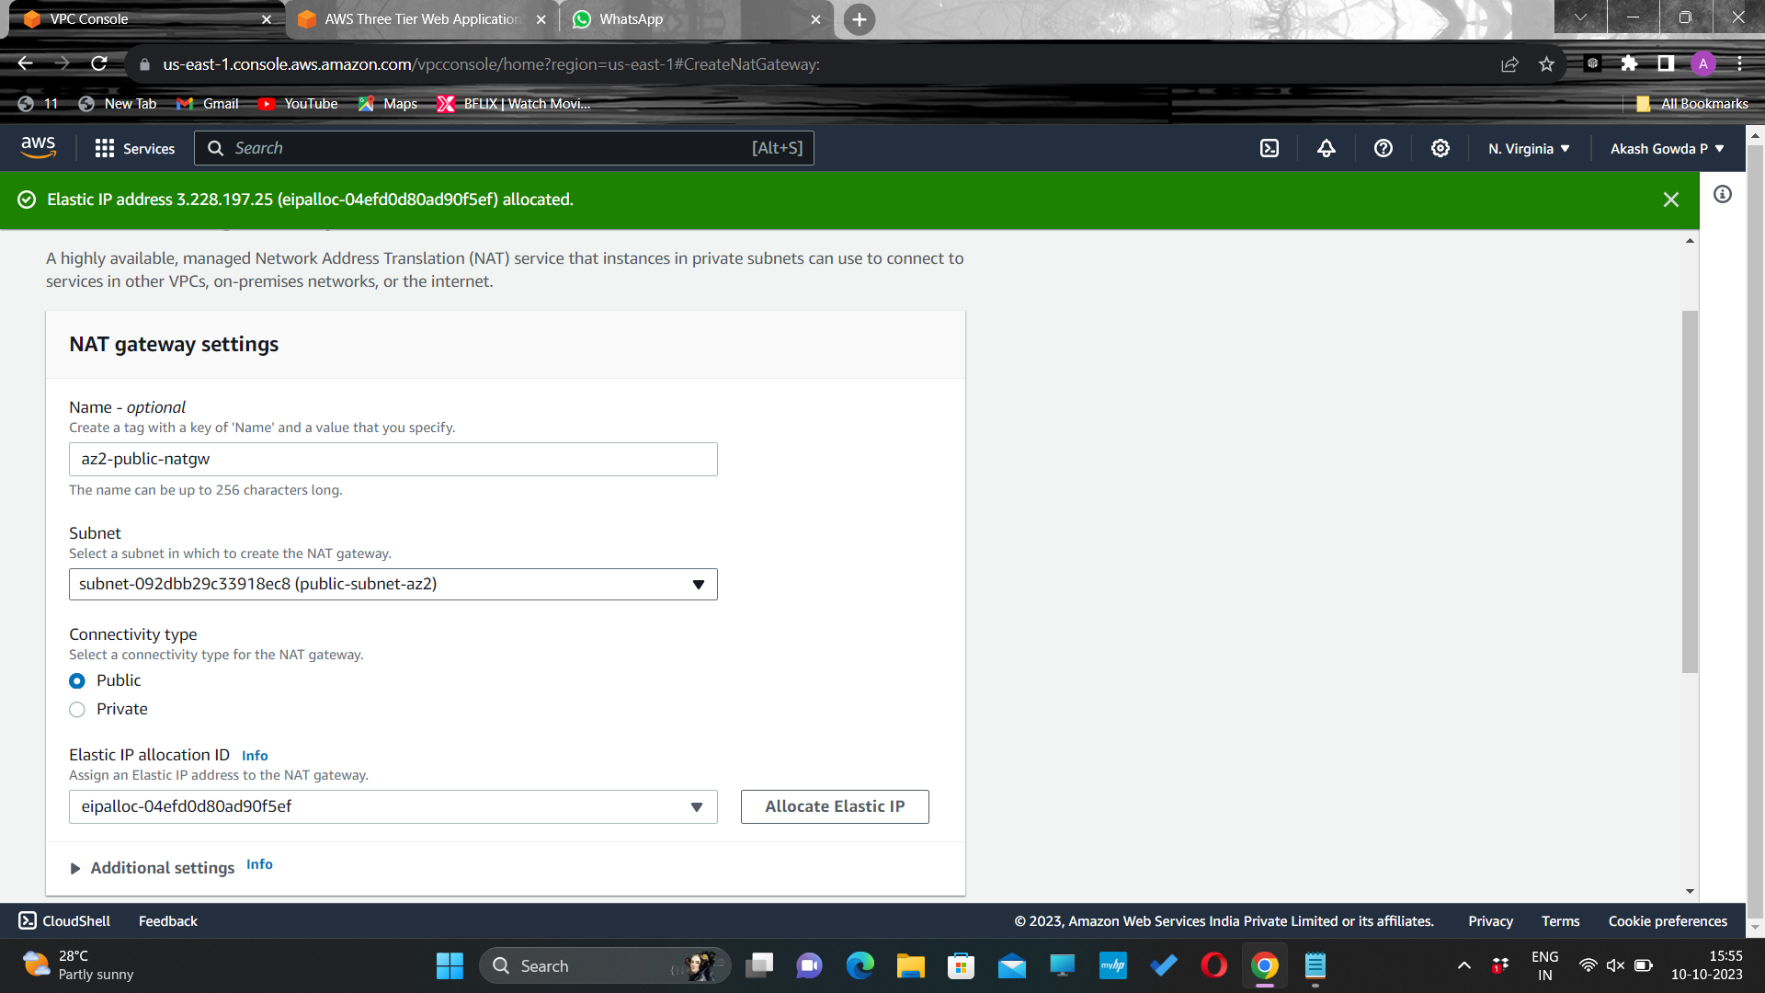
Click Create NAT gateway.
Create another NAT gateway in the other public subnet with different AZ

Slide 22

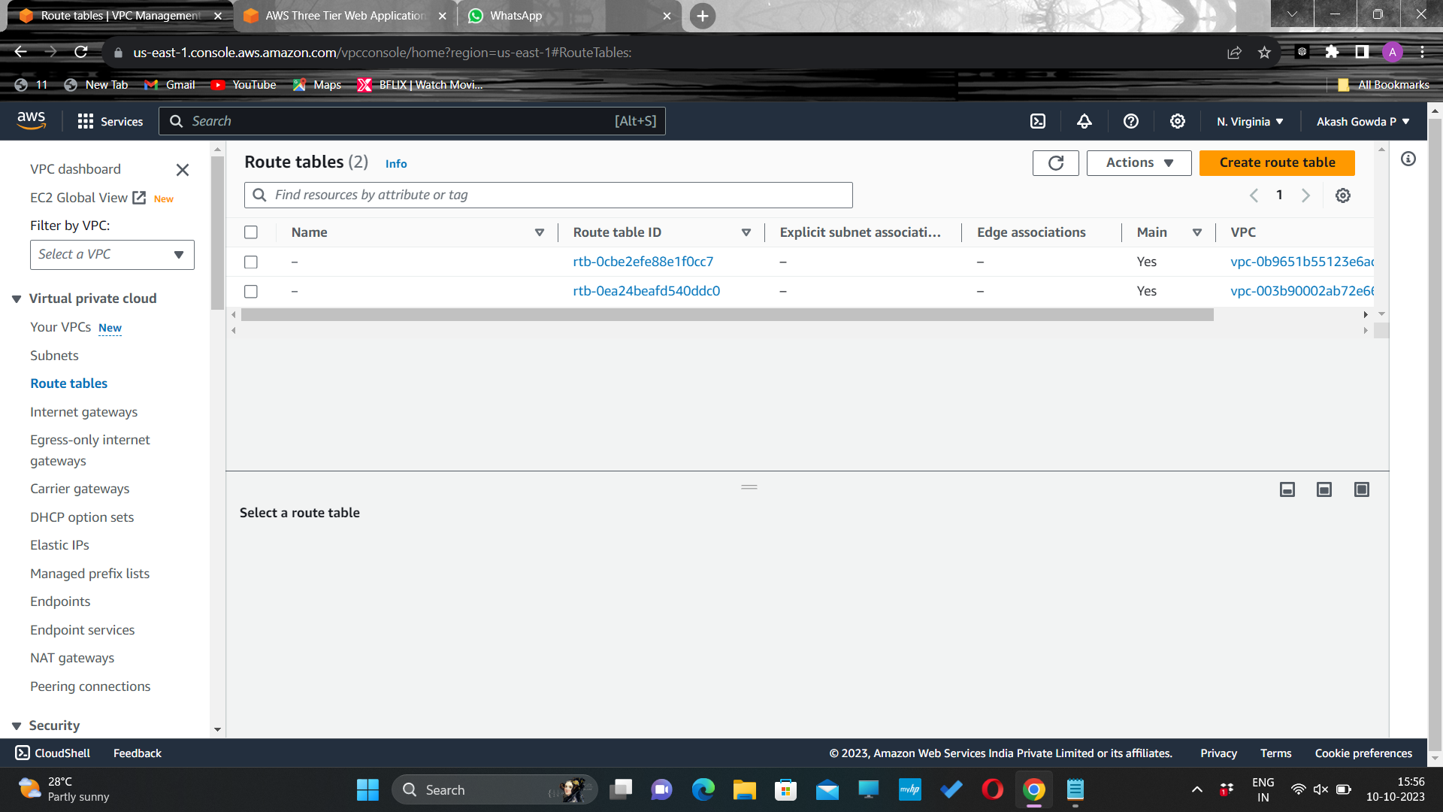
Routing Configuration
Click Create NAT gateway.
Navigate to Route Tables on the left side of the VPC dashboard and click Create route table

Slide 23
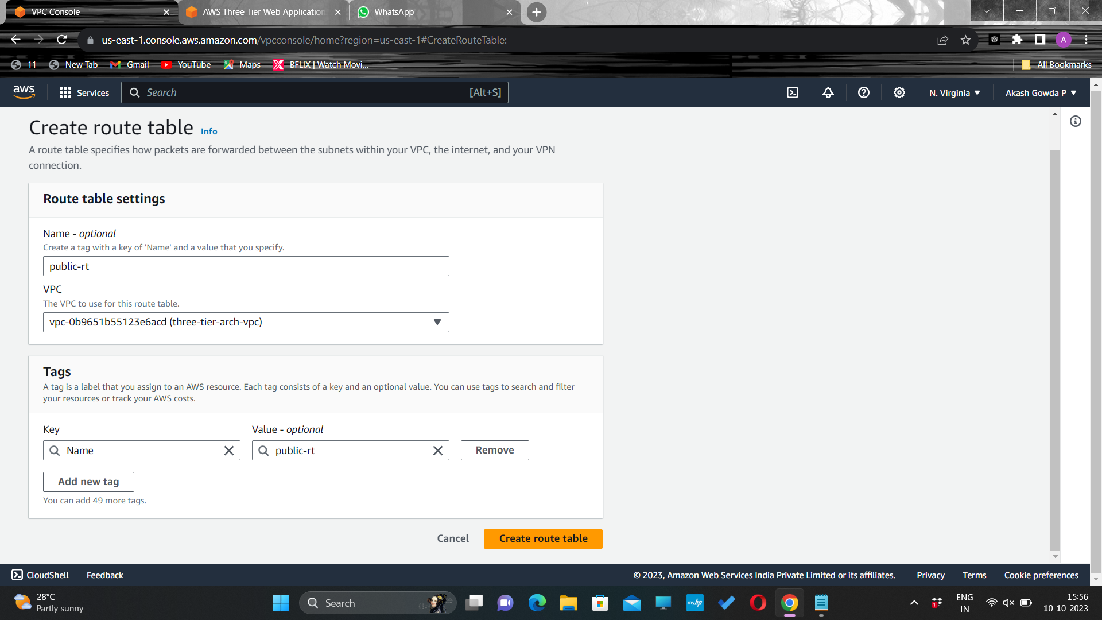
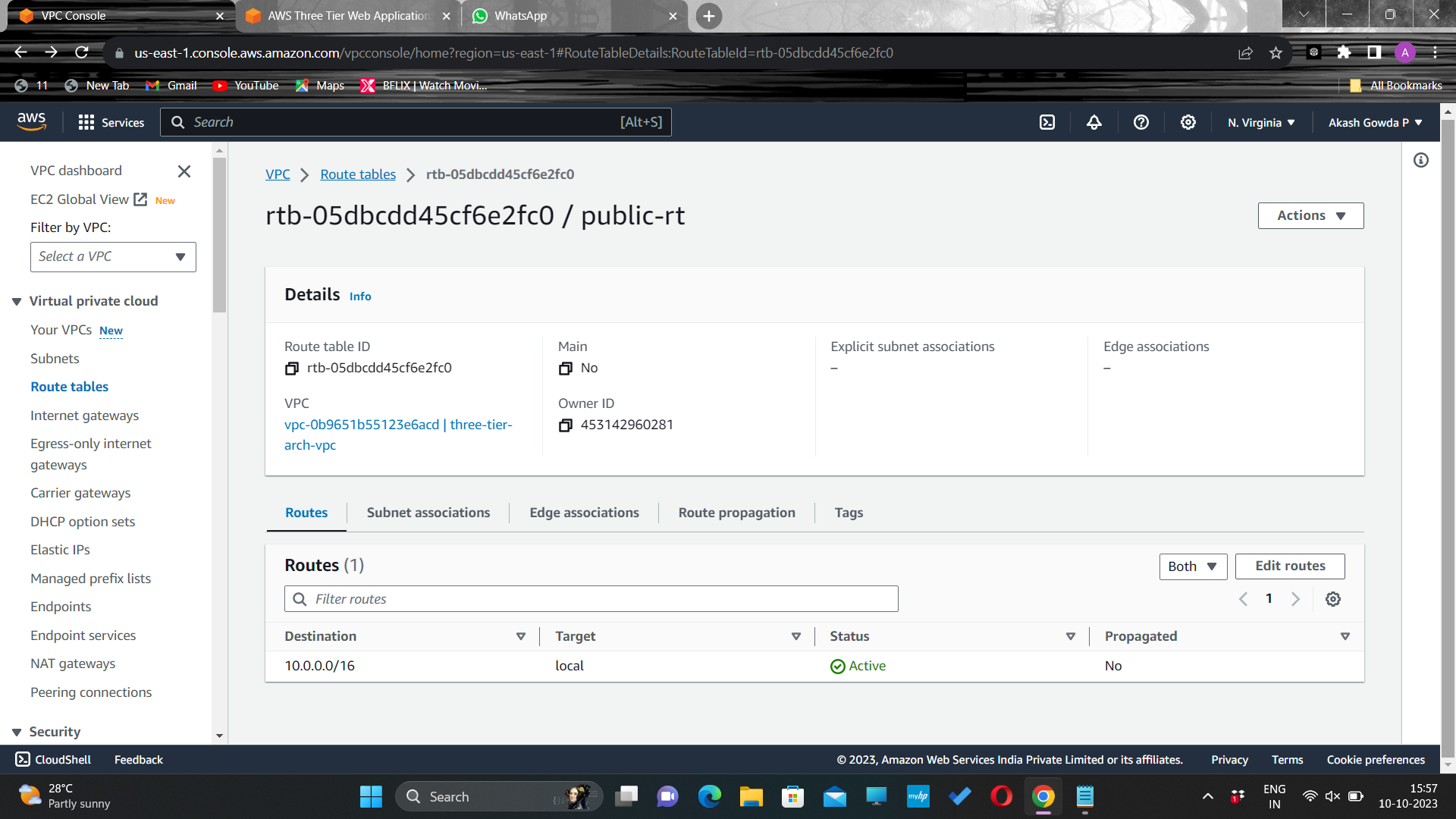
Create a route table for the web layer public subnets and name it accordingly.
Give a name and select the created VPC and click Create route table
Scroll down and click on the Routes tab and Edit routes.

Slide 24
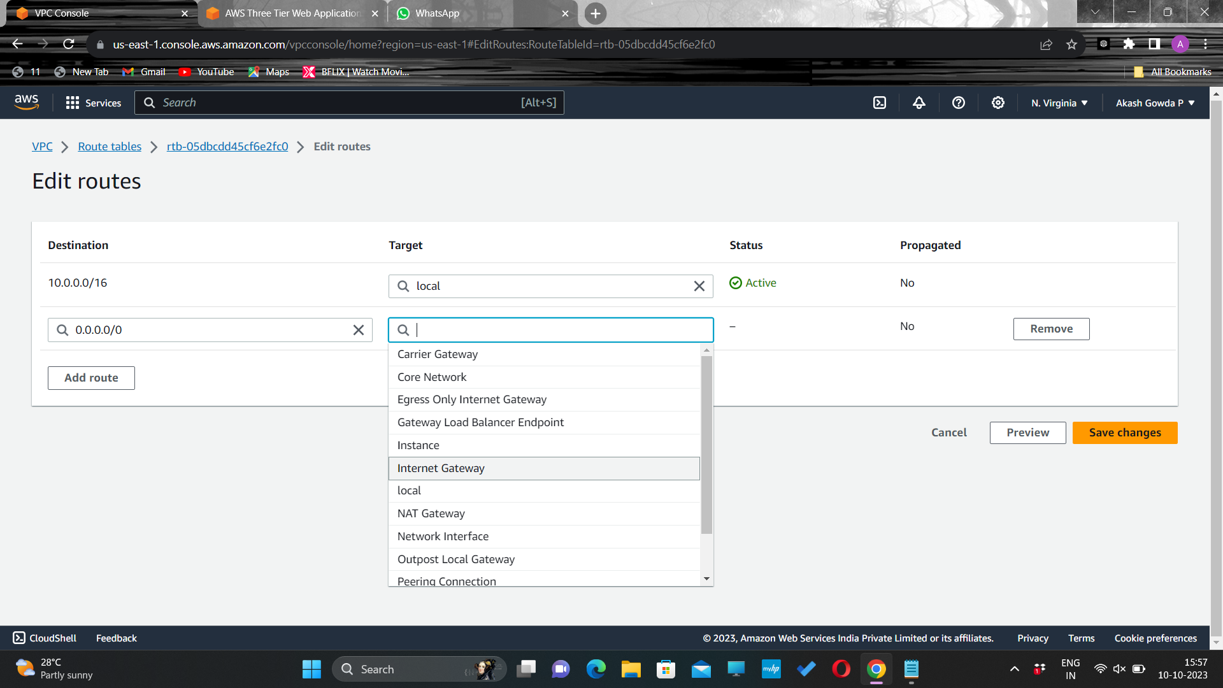
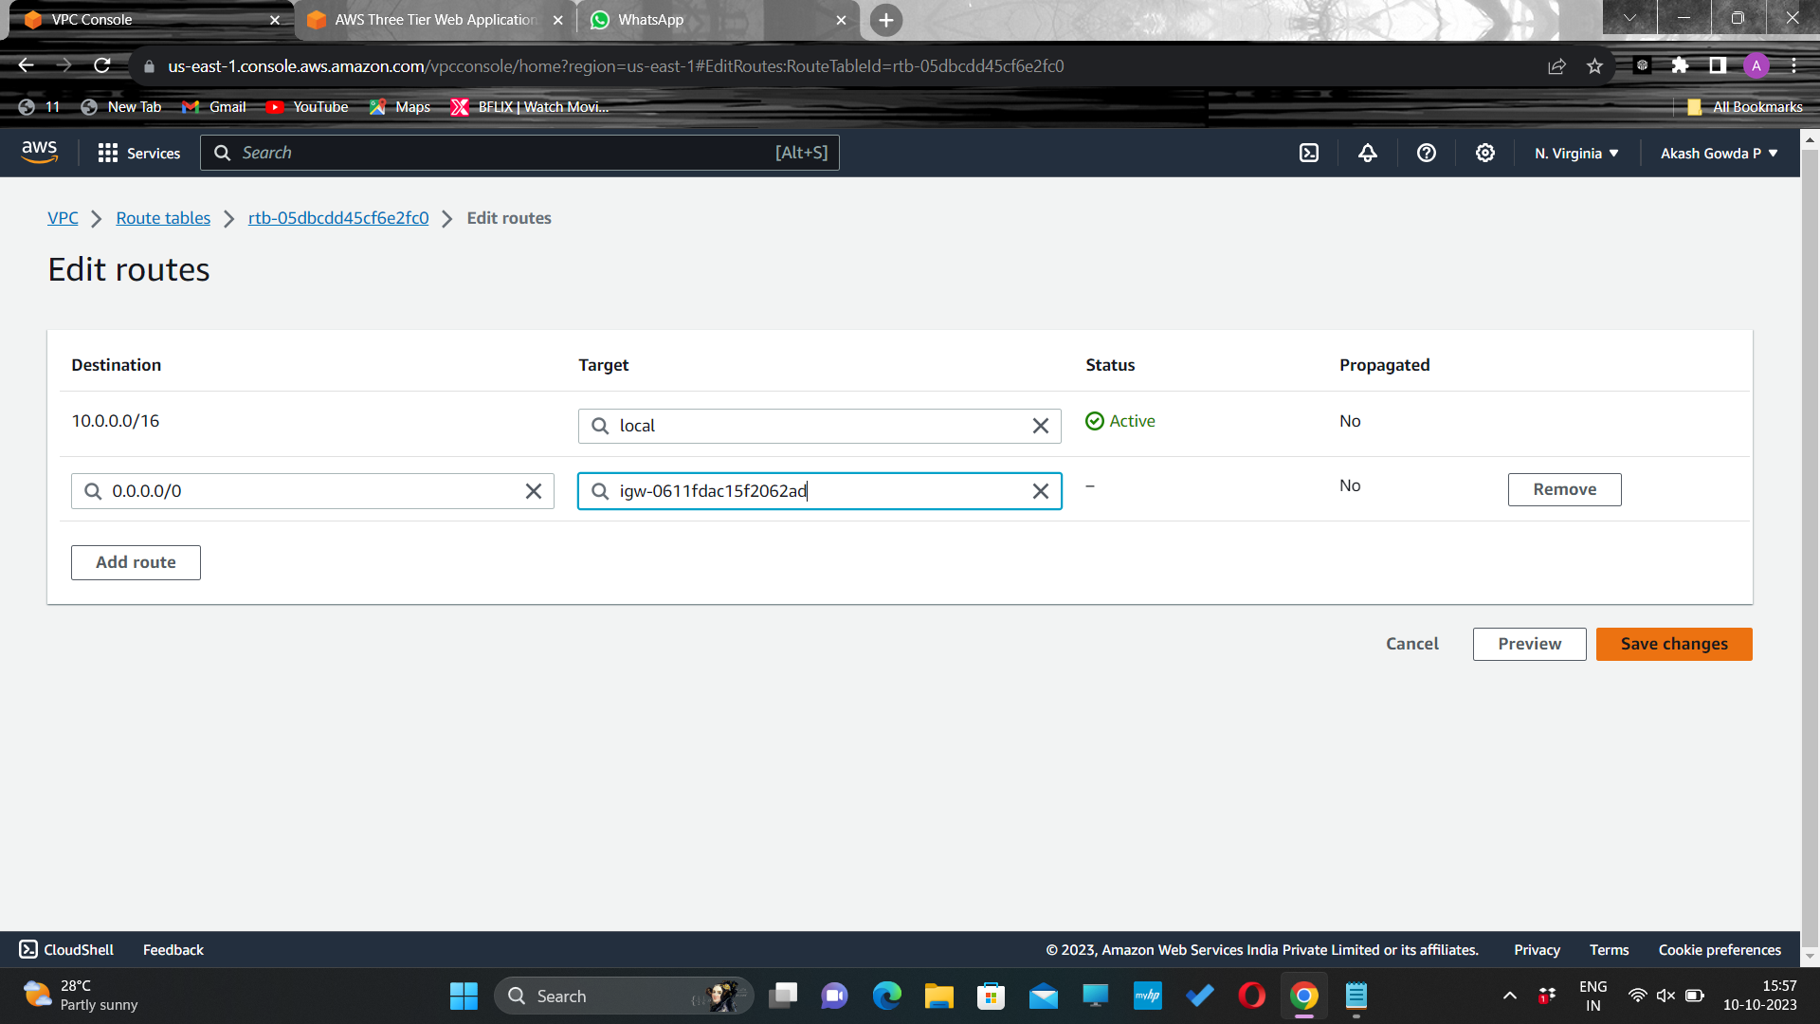
Add a route that directs traffic from the VPC to the internet gateway.
Select the internet gateway created and click Save changes

Slide 25
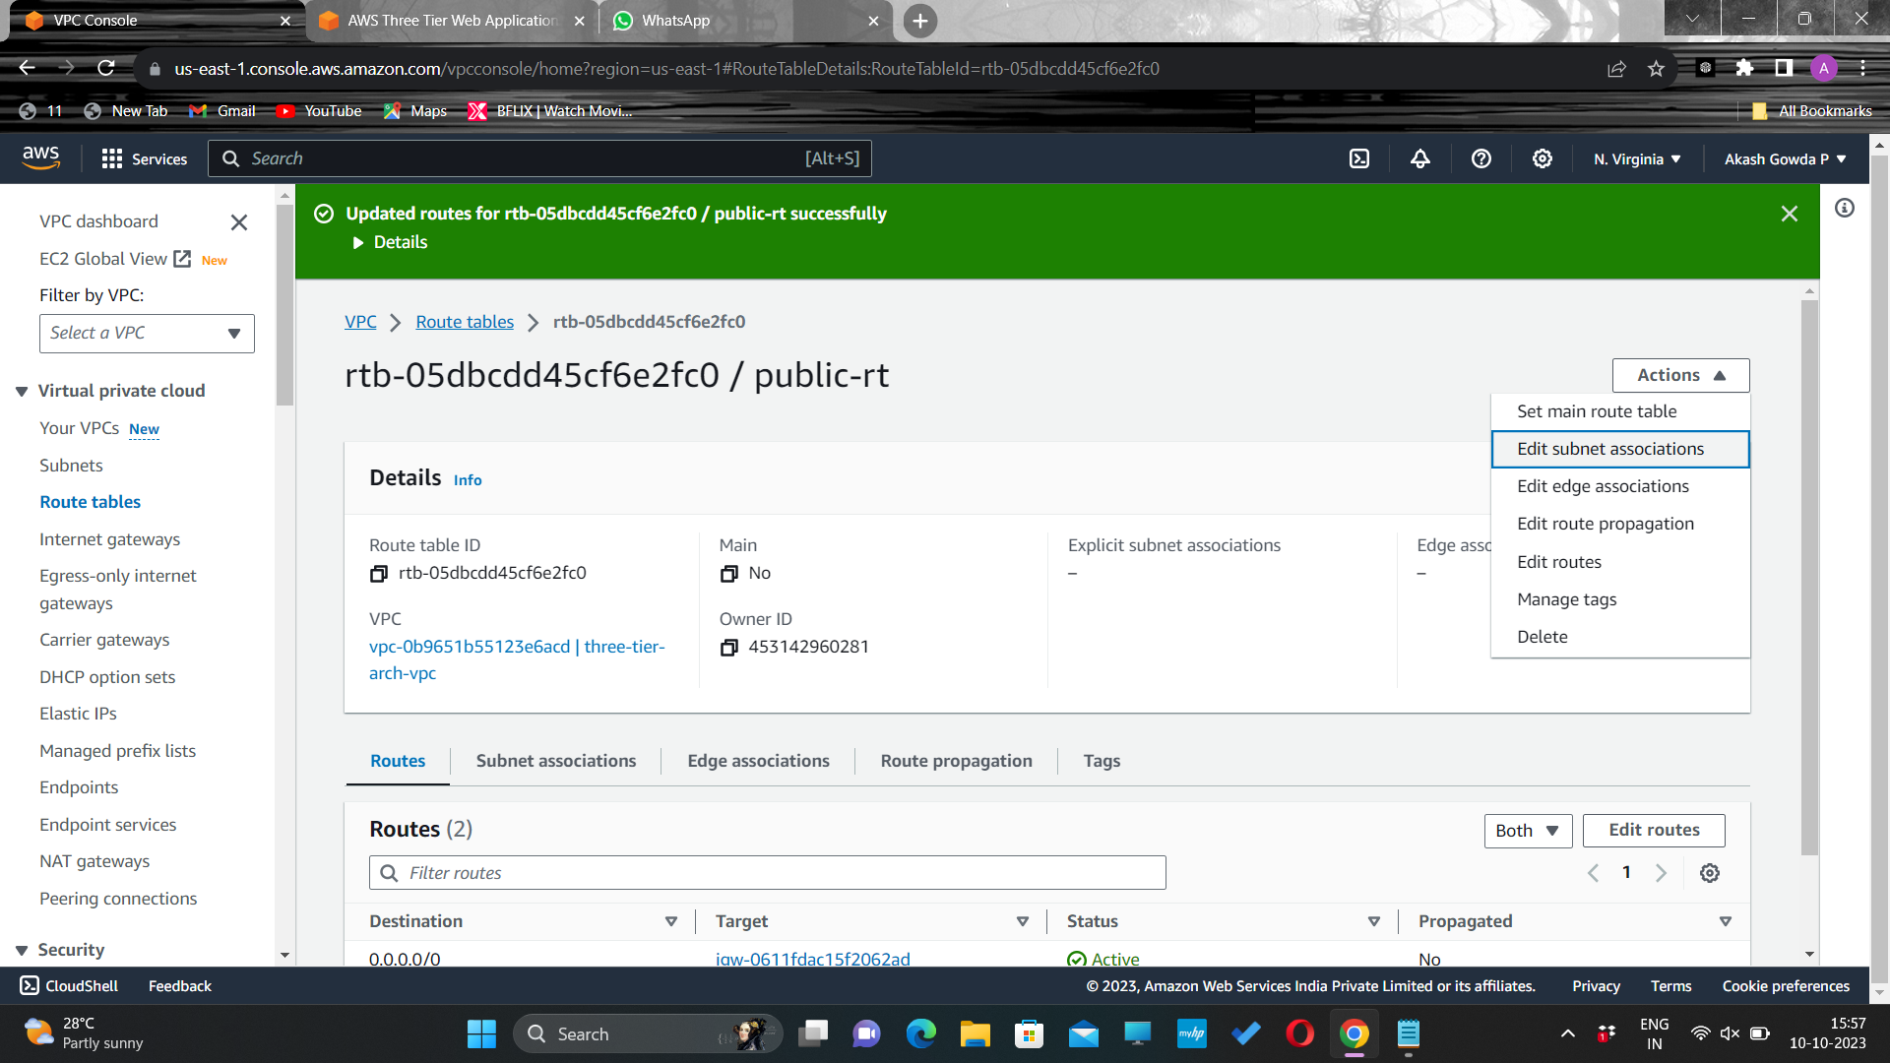
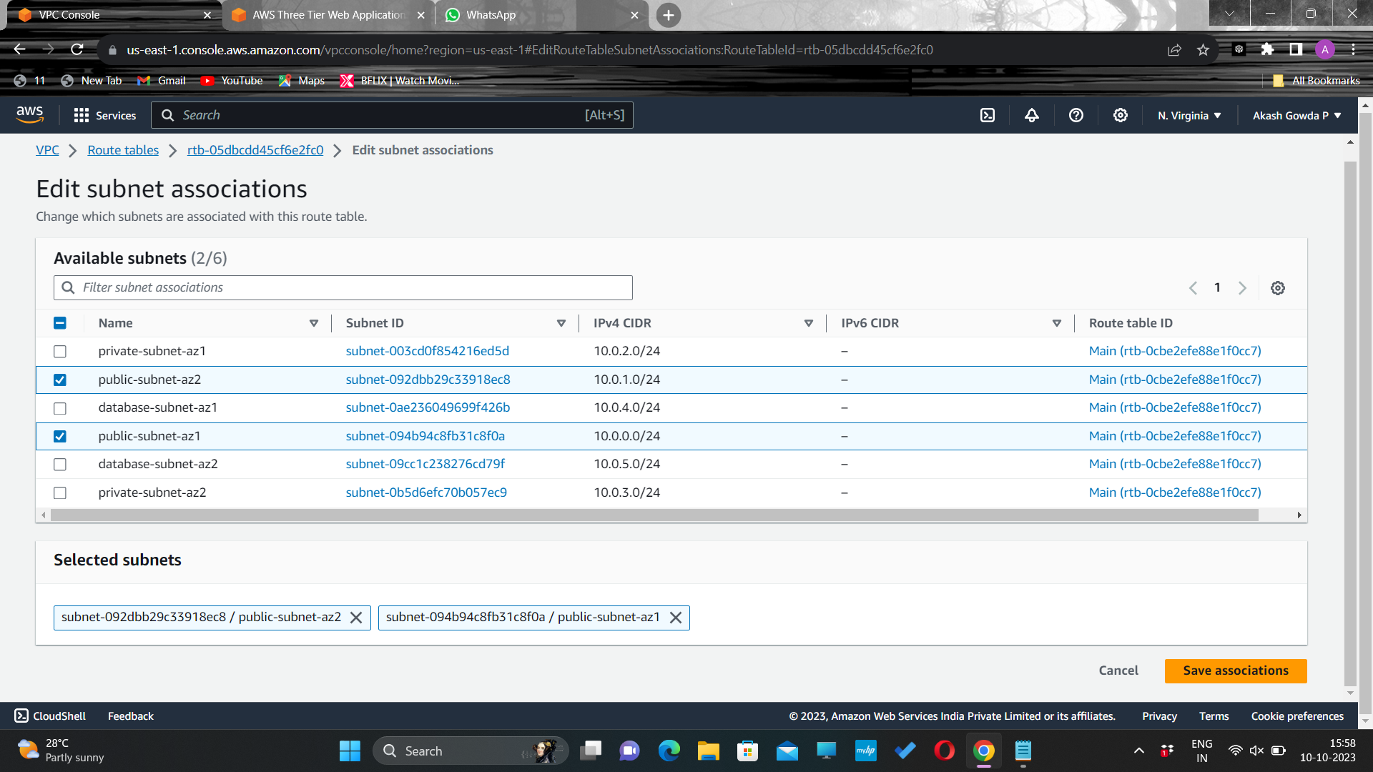
Select Subnet Associations and click Edit subnet associations.
Select the two web layer public subnets you created eariler and click Save associations.

Slide 26

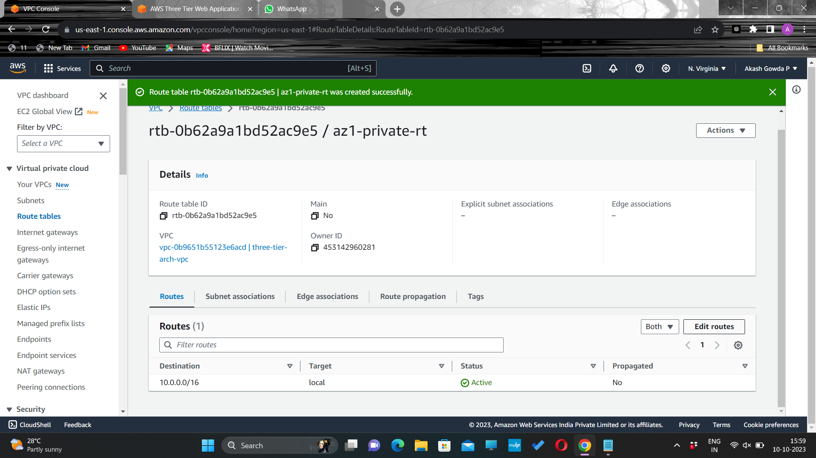
Now create 2 more route tables, one for each app layer private subnet in each availability zone. These route tables will route app layer traffic destined for outside the VPC to the NAT gateway in the respective availability zone, so add the appropriate routes for that.
AZ1 route table to map private- app tier-subnet to AZ1-NAT gateway
Click on Edit routes

Slide 27


Select the destination to be internet and target to be the NAT Gateway-select the NAT gateway in the AZ1

Slide 28
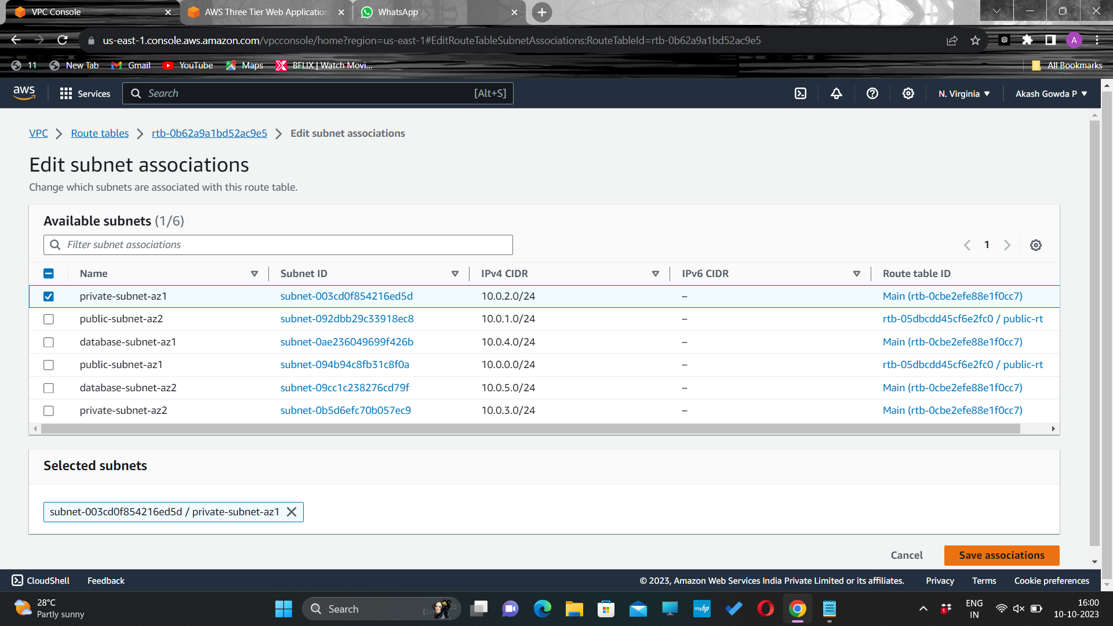

Edit the subnet association by selecting private subnet in az1
Create another route table which will be mapped to private subnet in AZ2(hence the name)

Slide 29
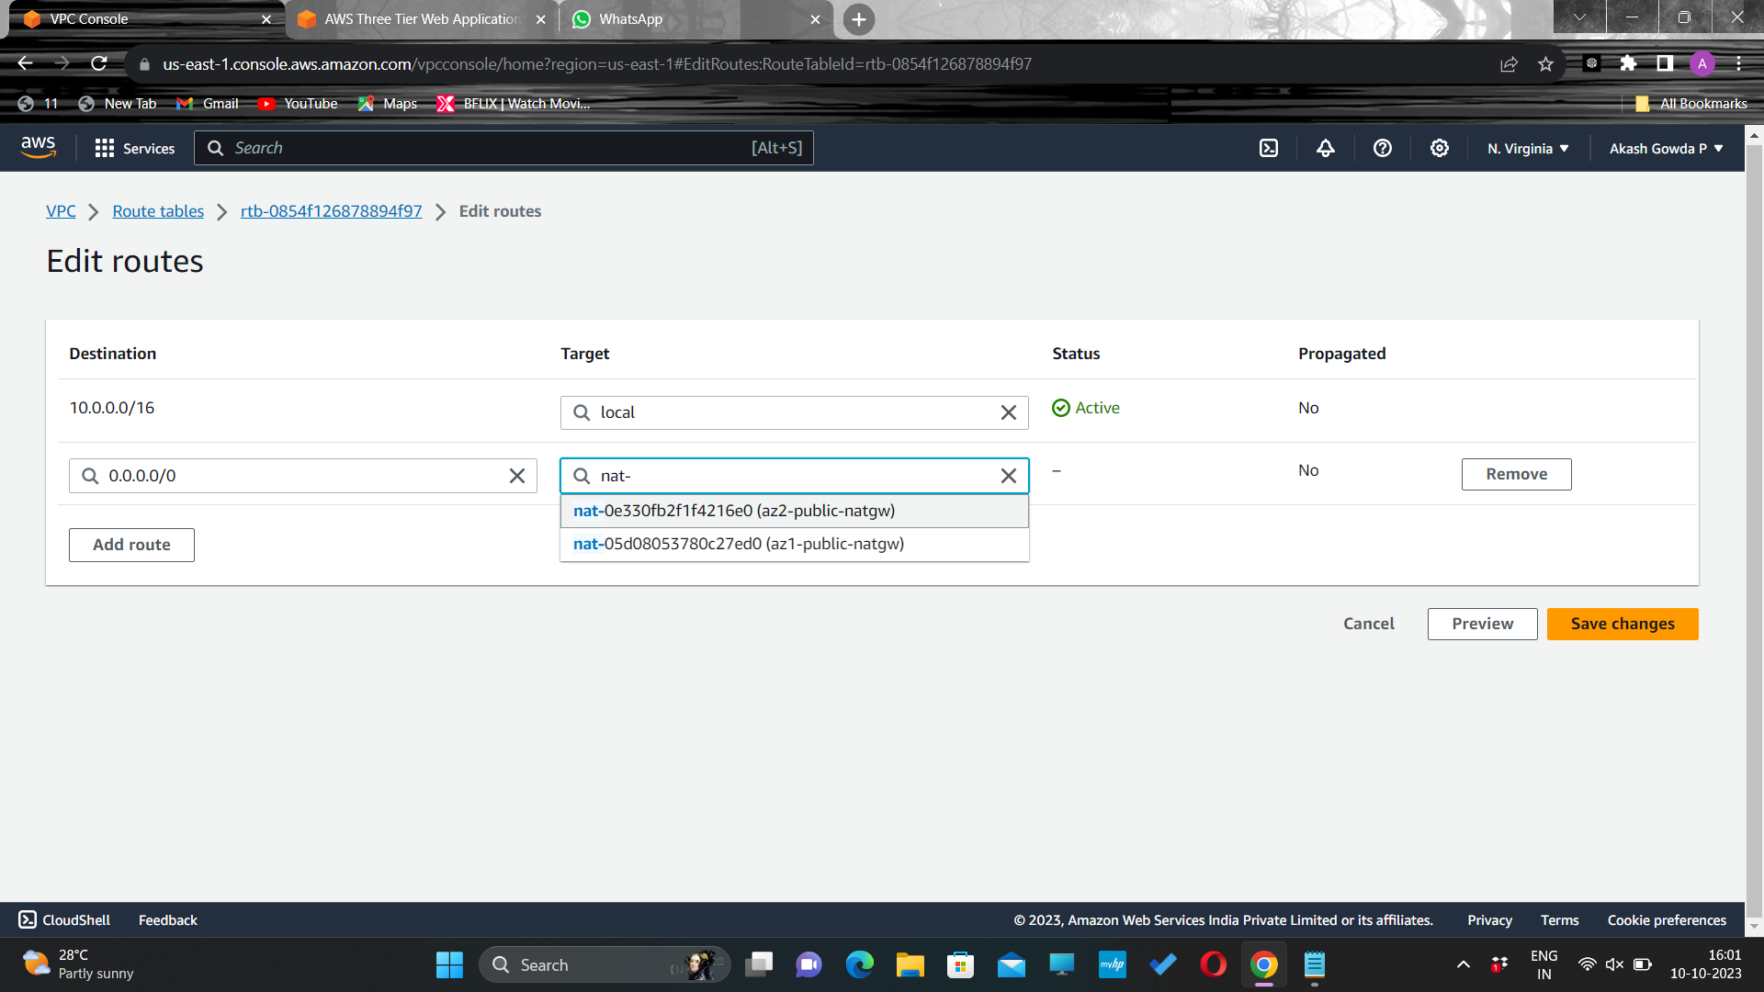
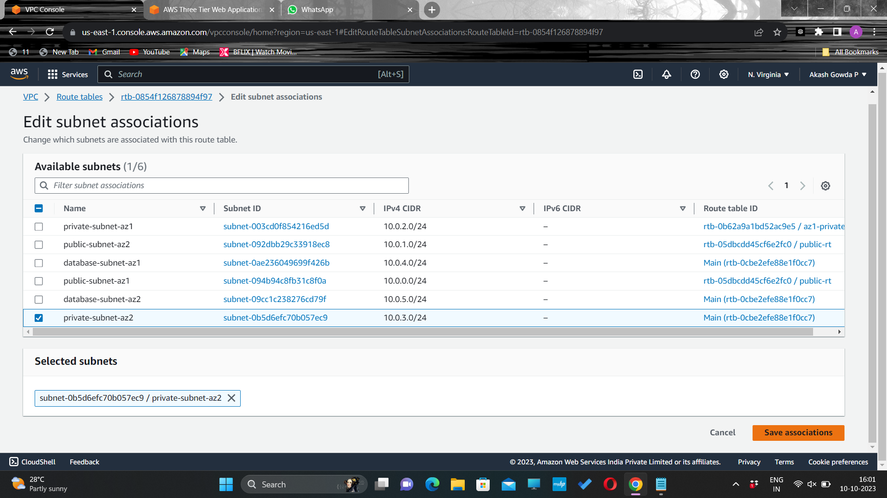
Edit the routes by adding internet access through NAT-gateway in AZ2 and associate the route table to the private subnet in AZ2

Slide 30
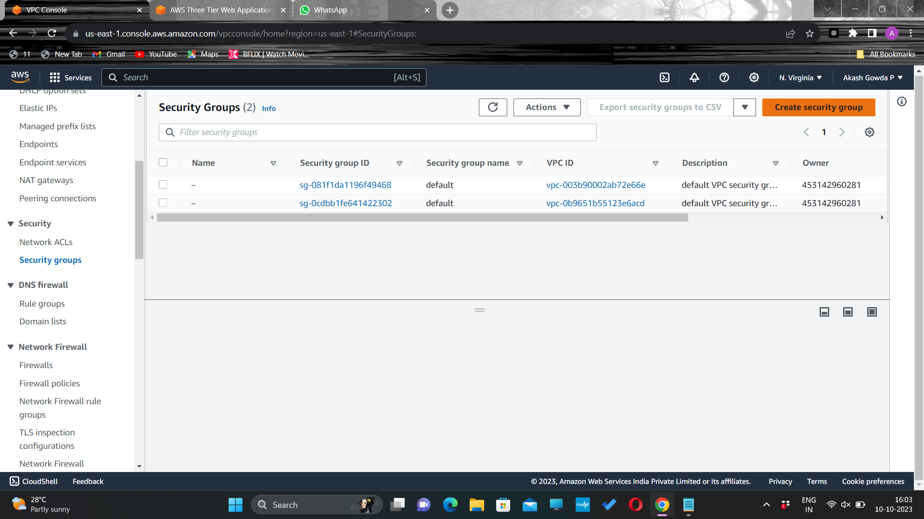
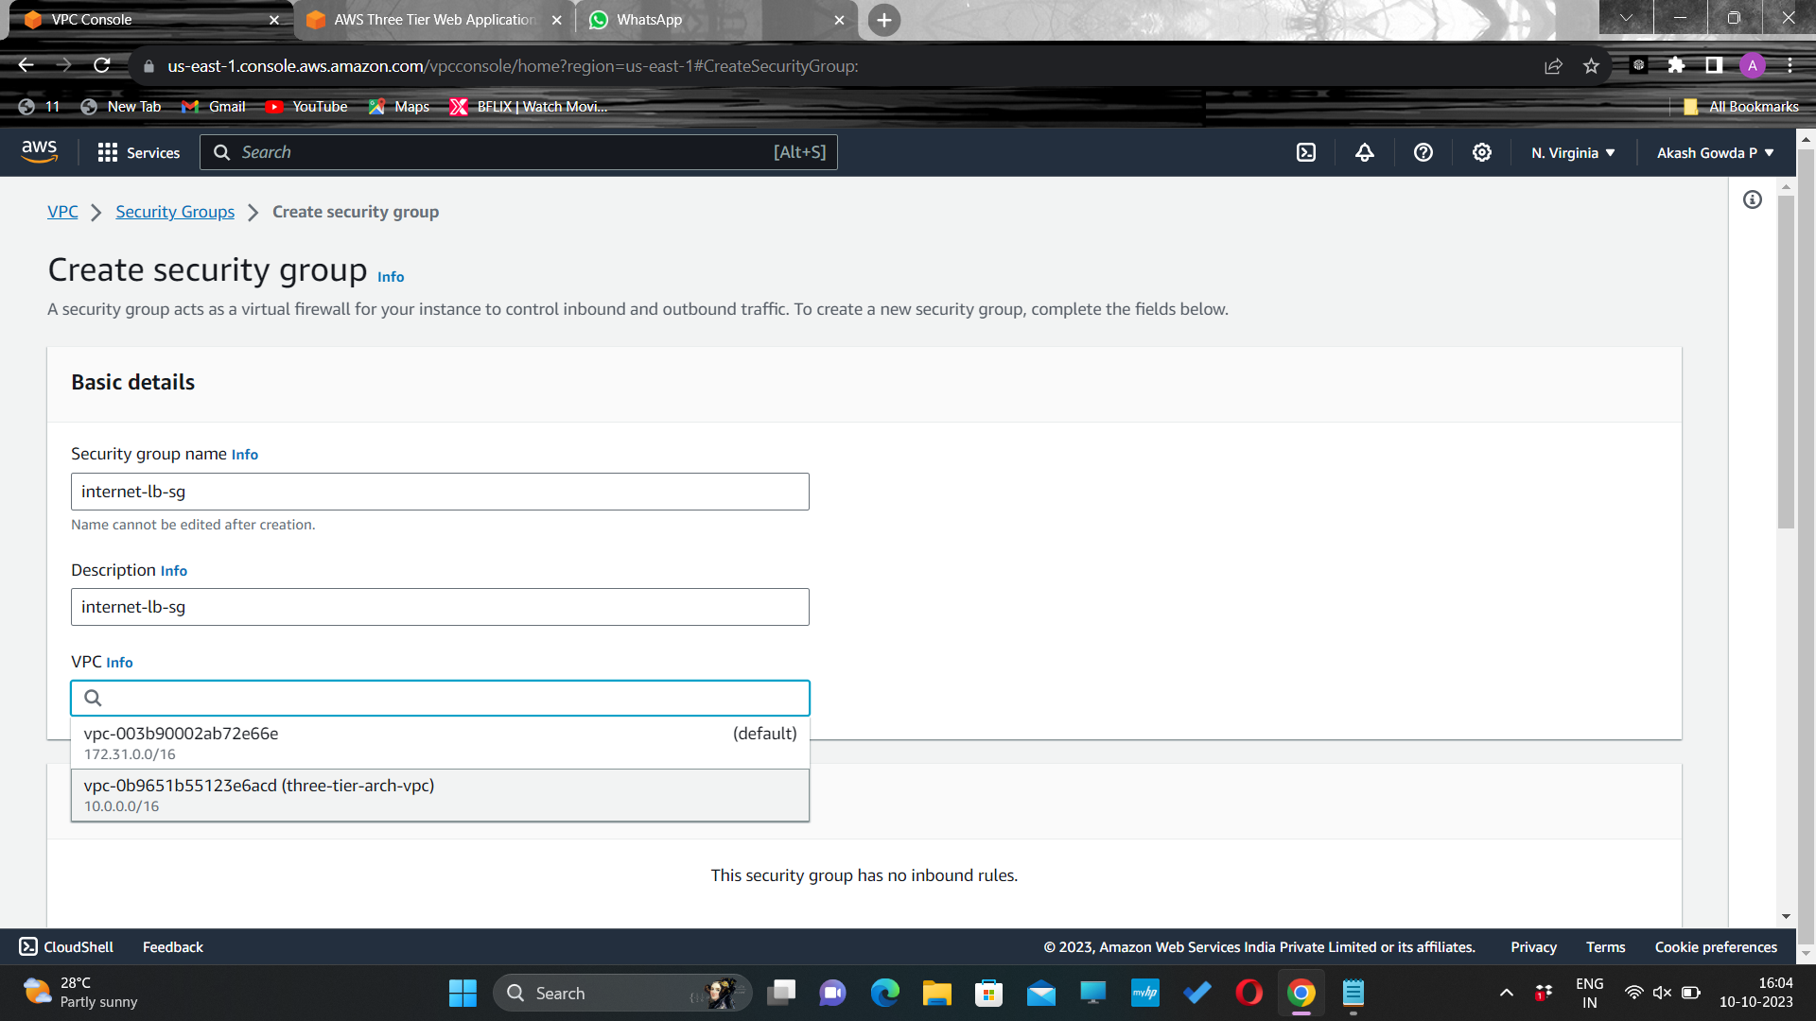
Security Groups
Navigate to Security Groups on the left side of the VPC dashboard, under Security.
SG for internet facing loadbalancer-give a name and description and select the VPC created

Slide 31
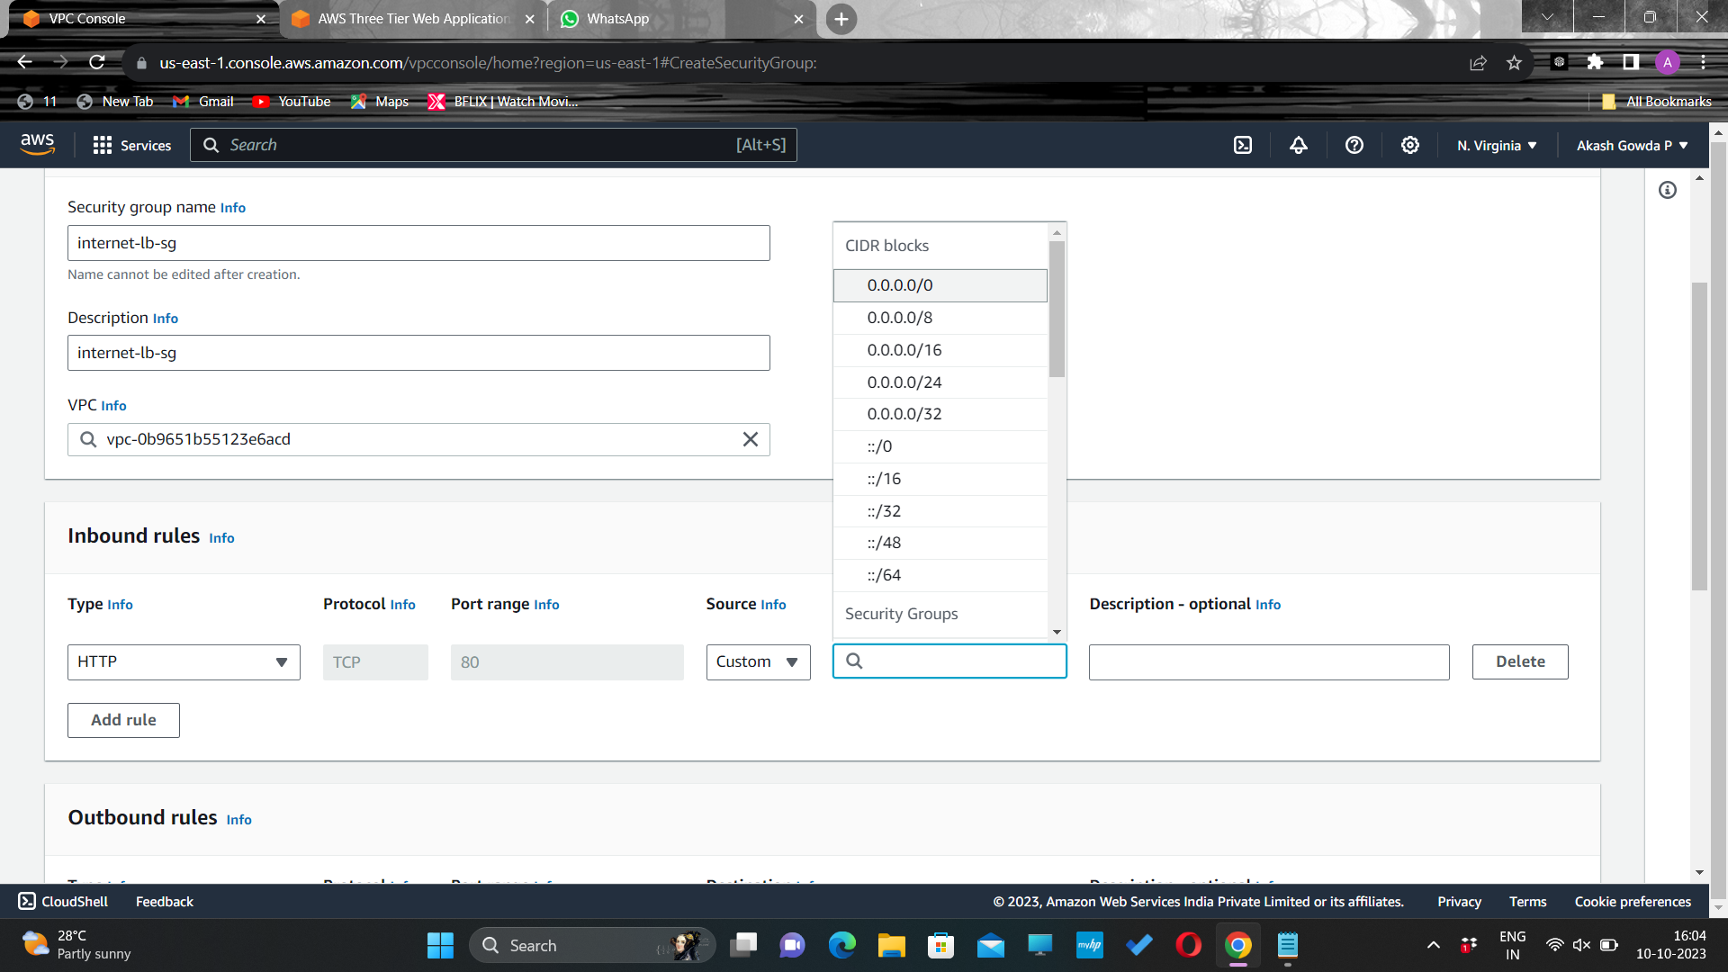
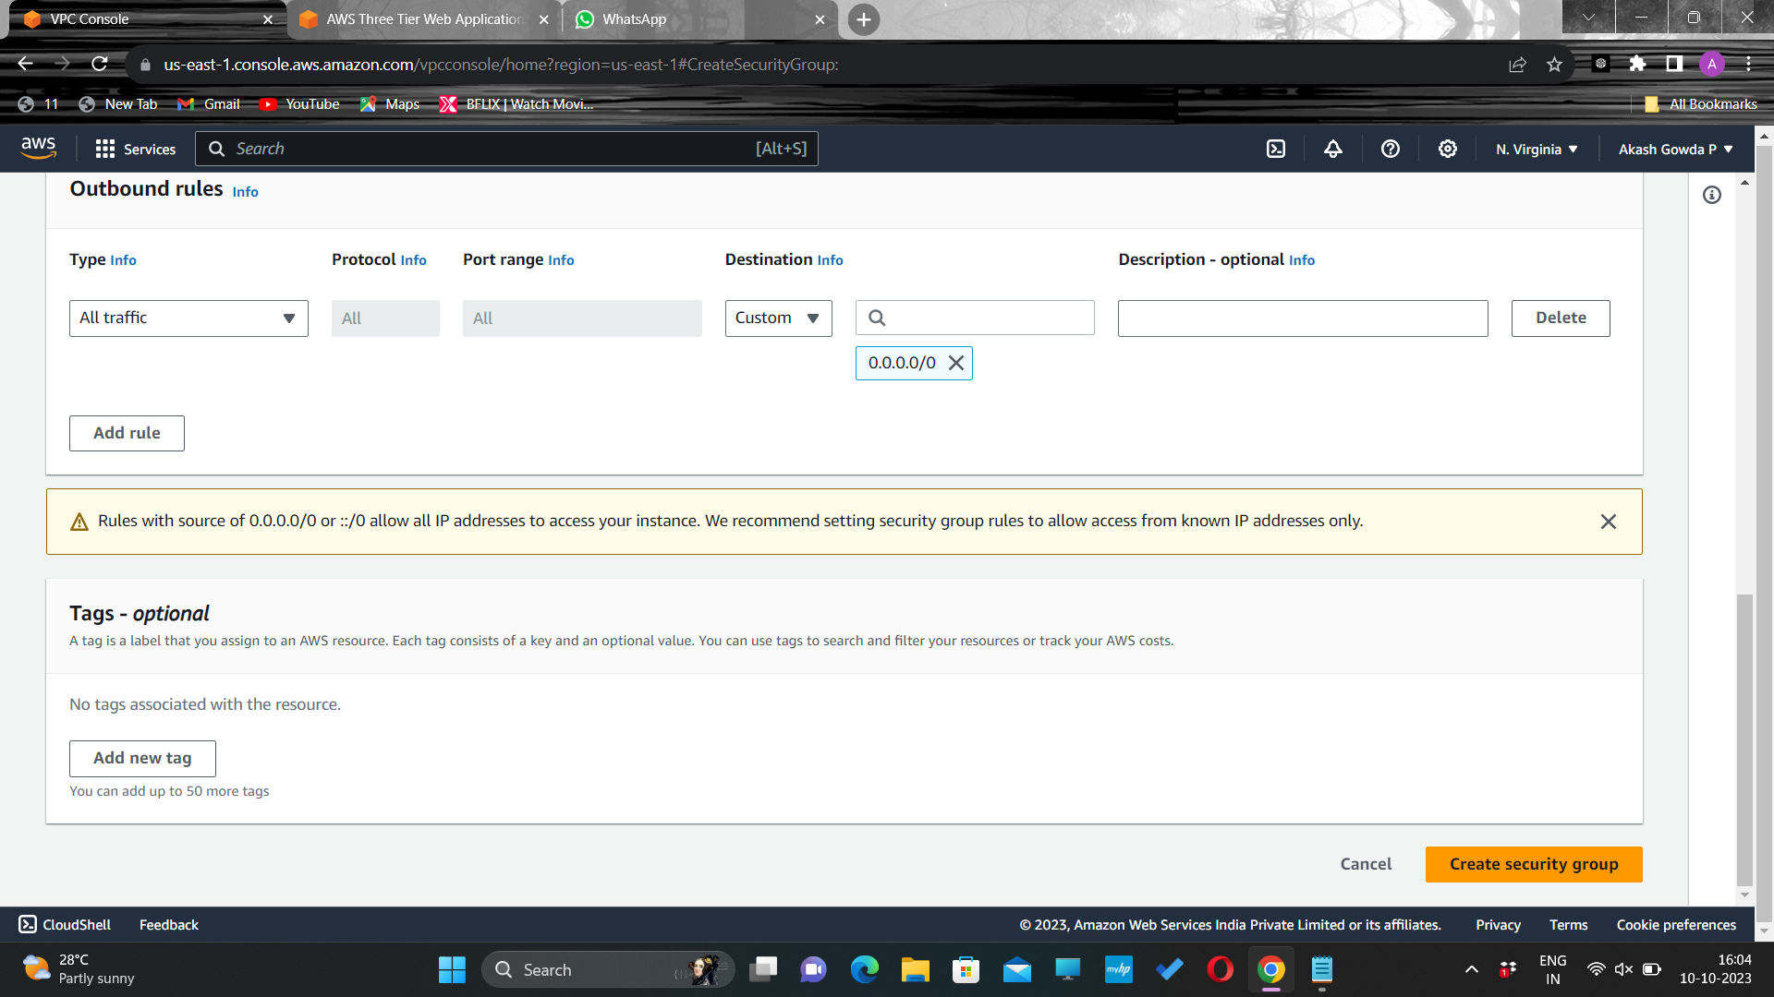
Add an inbound rule to allow HTTP type traffic for the internet(0.0.0.0/0) and click on Create security group

Slide 32
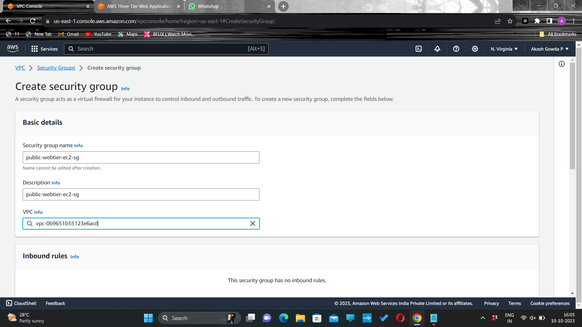
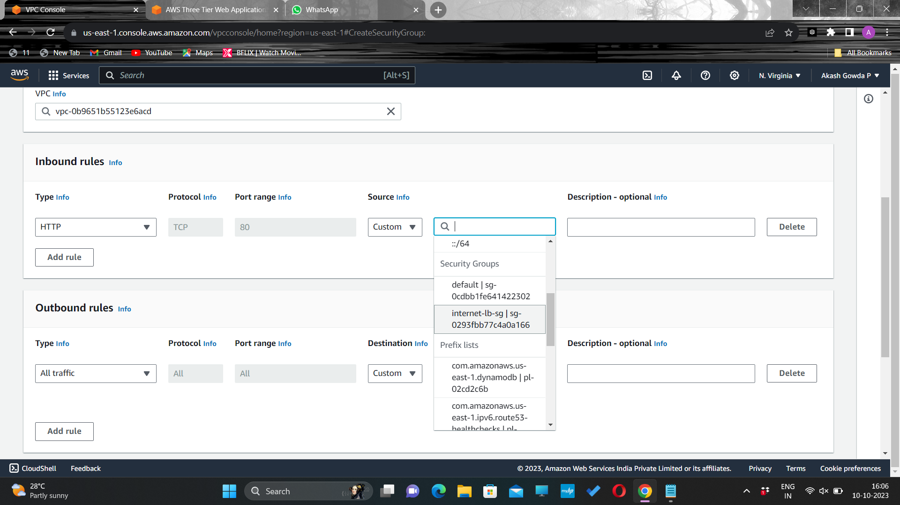
Security group for public-webtier-ec2 instance
Give a name and description and select the VPC created
Add an inbound rule that allows HTTP type traffic from your internet facing load balancer security group you created in the previous step

Slide 33
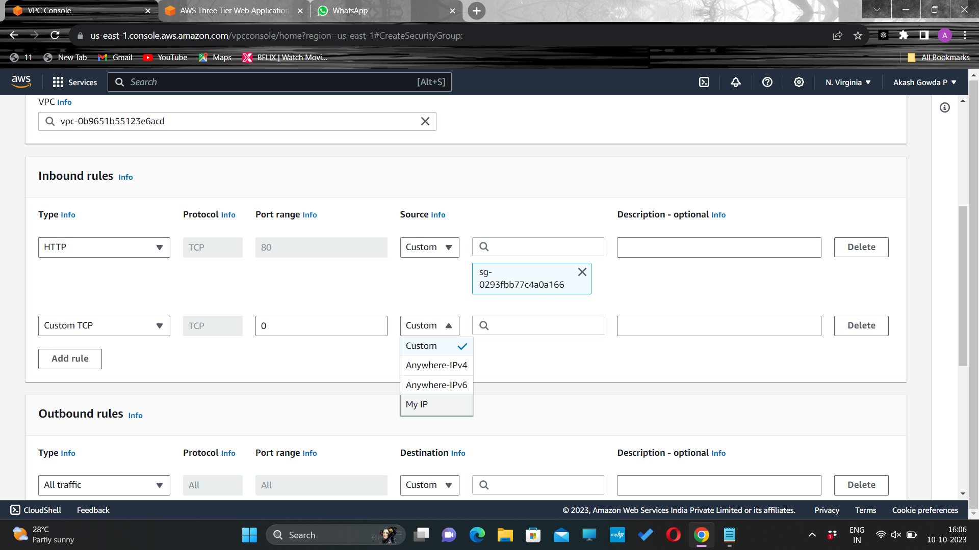
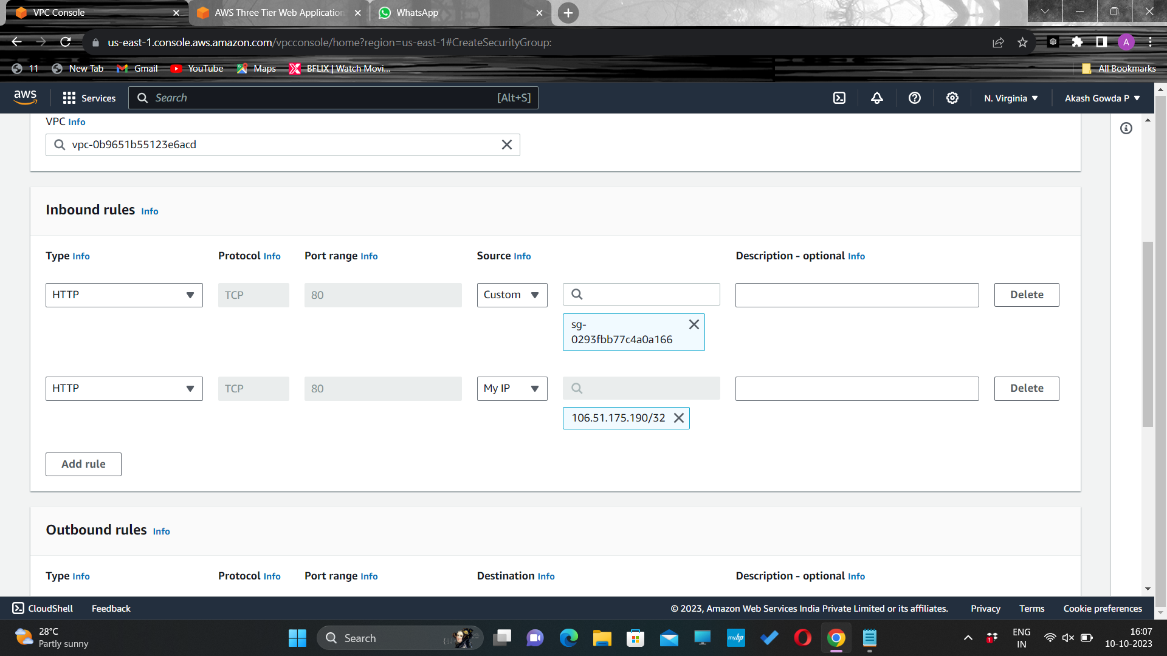
Add an additional rule that will allow HTTP type traffic for your IP. This will allow you to access your instance when we test.

Slide 34

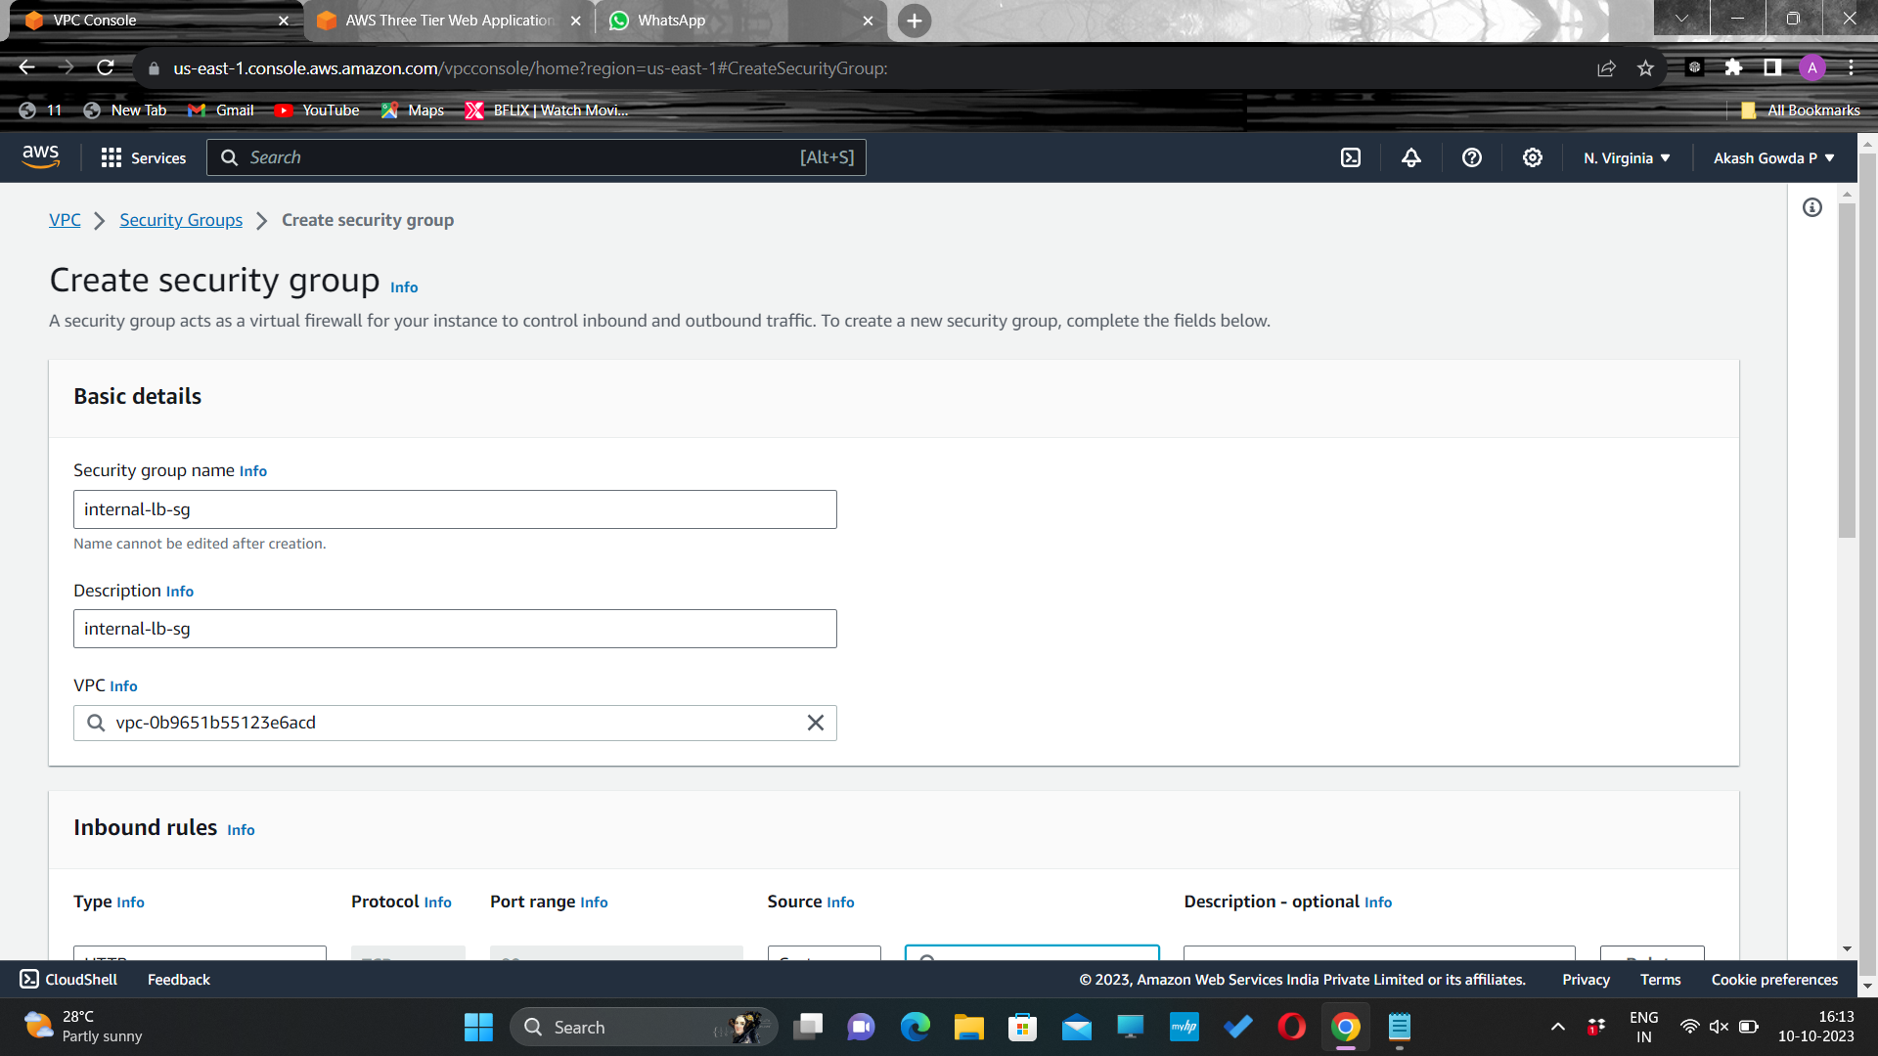
Security group for Internal load balancer
Give a name and description and select the VPC created

Slide 35
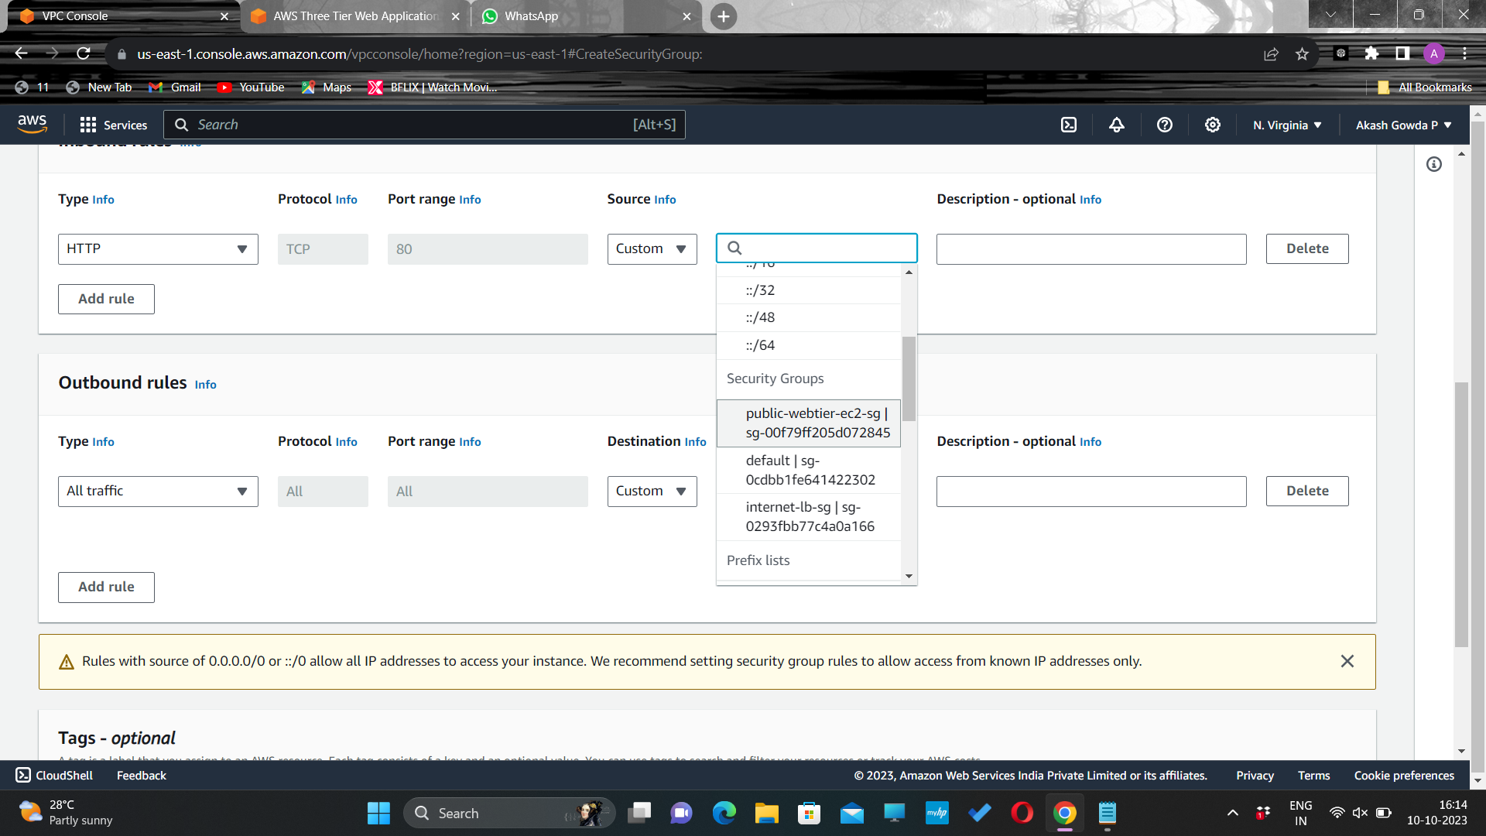

Add an inbound rule that allows HTTP type traffic from your public instance security group. This will allow traffic from your web tier instances to hit your internal load balancer.

Slide 36
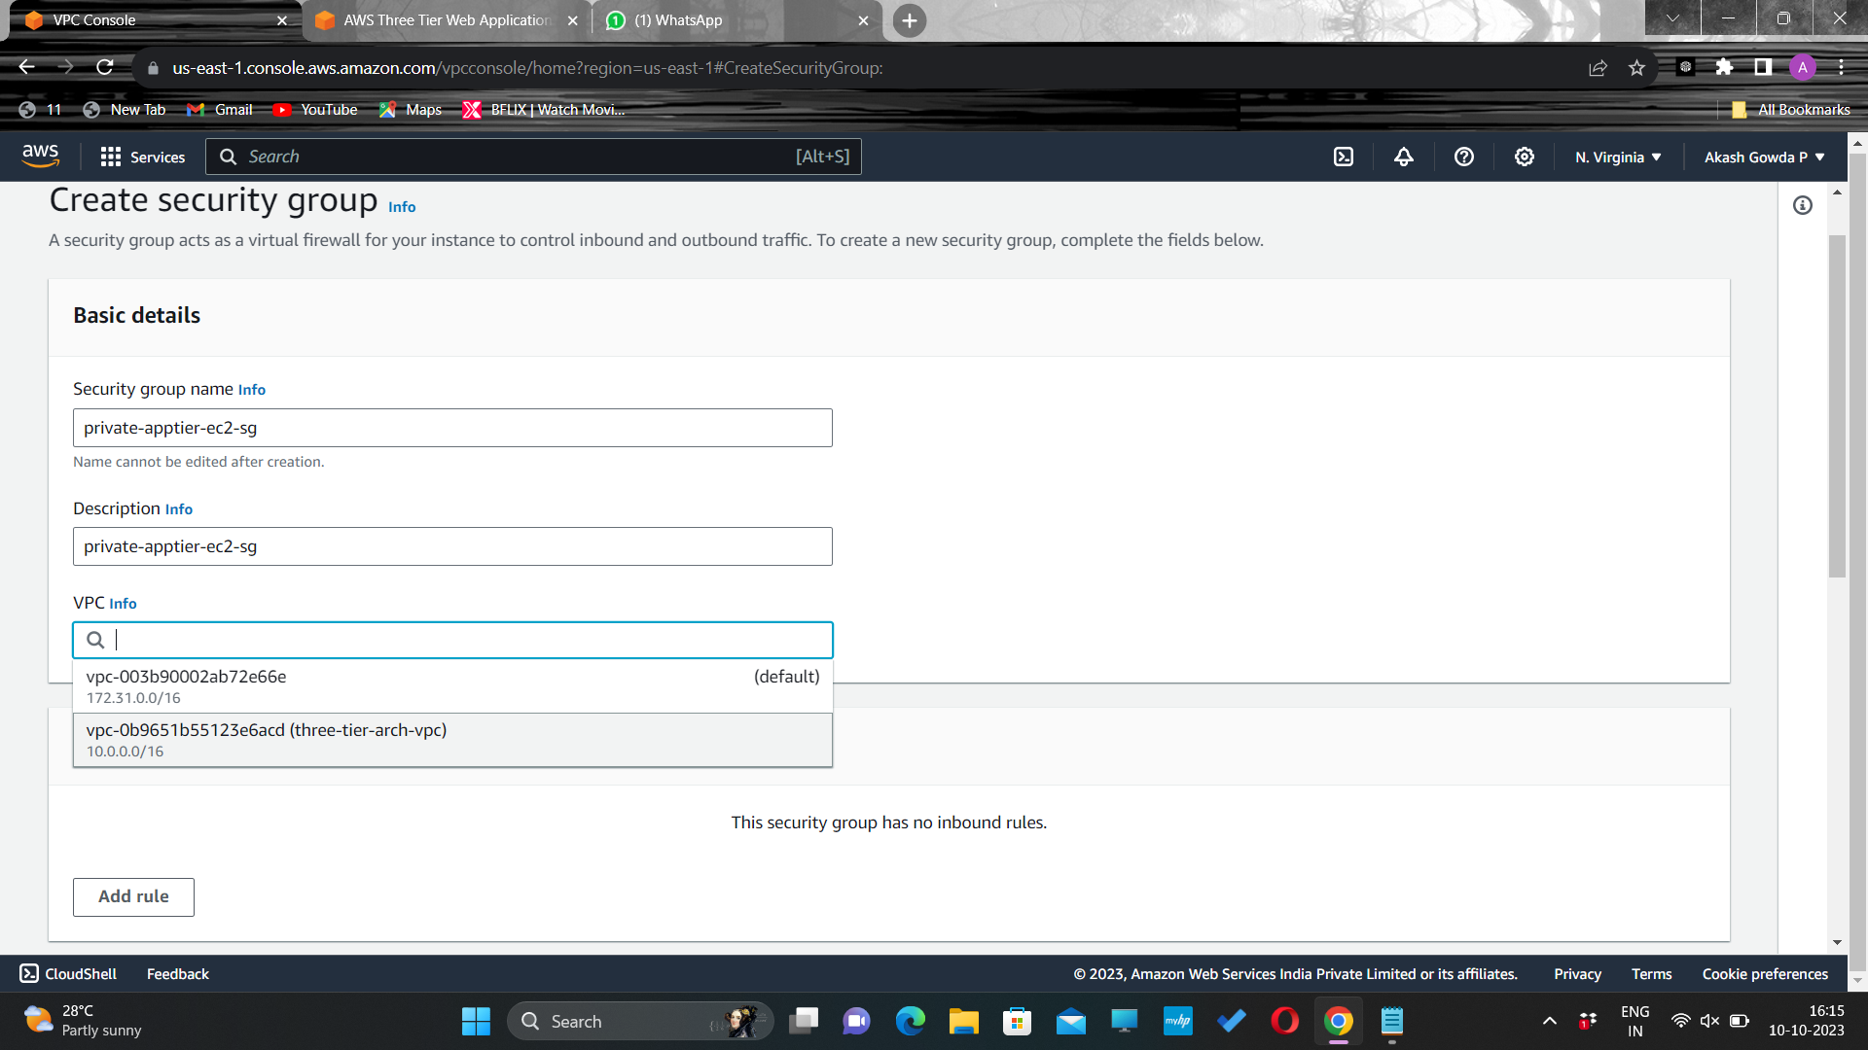
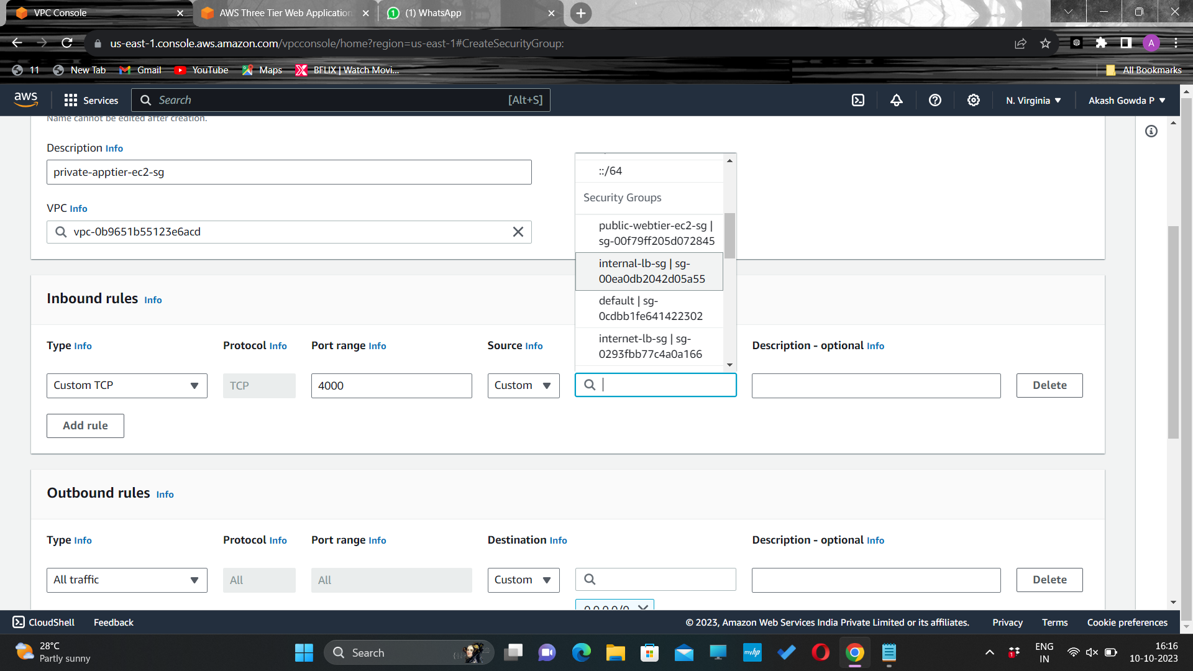
Security group for Private-app tier instance
Give a name and description and select the VPC created
Add an inbound rule that will allow TCP type traffic on port 4000 from the internal load balancer security group you created in the previous step.

Slide 37


This is the port our app tier application is running on and allows our internal load balancer to forward traffic on this port to our private instances. We should also add another route for port 4000 that allows My IP for testing.

Slide 38

Security group for Database instance
For this security group, add an inbound rule that will allow traffic from the private instance security group to the MYSQL/Aurora port (3306).

Slide 39
3.Database Deployment
Deploy Database Layer
Subnet Groups
Multi-AZ Database

Slide 40

Navigate to the RDS dashboard in the AWS console and click on Subnet groups on the left hand side.

Slide 41


Click Create DB subnet group.
Give your subnet group a name, description, and choose the VPC we created.

Slide 42


When adding subnets, make sure to add the subnets we created in each availability zone specifically for our database layer.
Navigate back to the VPC dashboard and check to make sure you're selecting the correct subnet IDs.

Slide 43


Make sure you have selected the right database subnets and Click on Create
Navigate to Databases on the left hand side of the RDS dashboard and click Create database.

Slide 44


Select Standard create for this MySQL-Compatible Amazon Aurora database. Leave the rest of the defaults in the Engine options as default.
Under the Templates section choose Dev/Test since this isn't being used for production at the moment.

Slide 45


Under Settings set a username and password of your choice and note them down since we'll be using password authentication to access our database.
Next, under Availability and durability change the option to create an Aurora Replica or reader node in a different availability zone.

Slide 46


Under Connectivity, set the VPC, choose the subnet group we created earlier, and select no for public access.

Slide 47


Set the security group we created for the database layer
Click on Create database

Slide 48
4.App Tier Instance Deployment
Create App Tier Instance
Configure Software Stack
Configure Database Schema
Test DB connectivity

Slide 49


Navigate to the EC2 service dashboard and click on Instances on the left hand side. Then, click Launch Instances.
Give a name to the instance and scroll down to select Amazon Linux 2 AMI.

Slide 50


Select T.2 micro(free tier) instance type.
Find network settings and click on edit to select the VPC that we created and select the private –subnet in any one of the AZ s

Slide 51


Select the security group created for the private-app tier instance
Find IAM instance profile in Advance details and select the role we created for ec2 instance

Slide 52
Commands to be used in app tier instance
1.sudo -su ec2-user
#switch to ec2-user
2.ping 8.8.8.8
#to ping the google DNS servers-to test internet connectivity through NAT-gateway
3.sudo wget https://dev.mysql.com/get/mysql57-community-release-el7-11.noarch.rpm
4.sudo rpm --import https://repo.mysql.com/RPM-GPG-KEY-mysql-2022
5.sudo yum install https://dev.mysql.com/get/mysql57-community-release-el7-11.noarch.rpm
6.sudo yum install mysql -y
#to install-mysql

Slide 53
7.mysql -h CHANGE-TO-YOUR-RDS-ENDPOINT -u CHANGE-TO-USER-NAME -p
#enter the password
#inside my sql
7.1 CREATE DATABASE webappdb;
7.2 SHOW DATABASES;
7.3 USE webappdb;
7.4 CREATE TABLE IF NOT EXISTS transactions(id INT NOT NULL
AUTO_INCREMENT, amount DECIMAL(10,2), description
VARCHAR(100), PRIMARY KEY(id));
7.5 SHOW TABLES;
7.6 INSERT INTO transactions (amount,description) VALUES ('400','groceries');
7.7 SELECT * FROM transactions;
8.Exit

Slide 54


Navigate to your list of running EC2 Instances by clicking on Instances on the left hand side of the EC2 dashboard. When the instance state is running, connect to your instance by clicking the checkmark box to the left of the instance, and click the connect button on the top right corner of the dashboard. Select the Session Manager tab, and click connect. This will open a new browser tab for you.

Slide 55


Use the above provided commands to configure the app tier instance and establish the connection and schema for the Arora database created earlier

Slide 56



Slide 57


Navigate to the RDS Writer instance to find the Endpoint to use it in the command –to establish a connection

Slide 58



Slide 59


Open the application-code/app-tier/DbConfig.js file from the github repo in a text editor on your computer. You’ll see empty strings for the hostname, user, password and database. Fill this in with the credentials you configured for your database, the writer endpoint of your database as the hostname, and webappdb for the database. Save the file.

Slide 60


Upload the app-tier folder to the S3 bucket that you created

Slide 61



Slide 62



Slide 63



Slide 64



Slide 65



Slide 66


Navigate to Instances on the left hand side of the EC2 dashboard. Select the app tier instance we created and under Actions select Image and templates. Click Create Image.

Slide 67


Give a name to the image and scroll down to find Create image button.

Slide 68


Find Target groups and create a target group for the auto scaling group of application tier and add the app tier instance in the target.

Slide 69



Slide 70


Navigate to Load Balancers and click on Create load balance.

Slide 71


Select Application load balancer and select Internal (as we are using internal load balancer)

Slide 72


Select the VPC we created and private subnet in both Availability zones

Slide 73


Select the target group we created and click on Create load balancer.

Slide 74


Navigate to Launch templates and click on Create launch template and select the AMI we created using the app tier instance by clicking on My AMIs

Slide 75


Select the Instance type and Security group we created for the app tier.

Slide 76


Click on create launch template.

Slide 77


Navigate to Auto scaling group and select the Launch template we created and click on next

Slide 78


Select the VPC and private subnet in AZ1 and AZ2 and click on Next

Slide 79


Select Attach to an existing load balancer and select the target group we created.

Slide 80


Select the Desired capacity and min and max capacity and click on create.

Slide 81


Navigate to Instances on the left hand side of the EC2 dashboard. Select Instance and click on Launch instance to create web tier instance.

Slide 82


Navigate to Advanced details and select IAM instance profile to attach the role we created.

Slide 83


Open up the application-code/nginx.conf file from the repo we downloaded. Scroll down to line 58 and replace [INTERNAL-LOADBALANCER-DNS] with your internal load balancer’s DNS entry. You can find this by navigating to your internal load balancer's details page. Then, upload this file and the application-code/web-tier folder to the s3 bucket .

Slide 84
Commands to be used in Web tier instance
curl -o- https://raw.githubusercontent.com/nvm-sh/nvm/v0.38.0/install.sh | bash
source ~/.bashrc
#to install node version manager(NVM)
nvm install 16
nvm use 16
npm install -g pm2
#PM2 is a daemon process manager that will keep our node.js app running when we exit the instance or if it is rebooted.
cd ~/
aws s3 cp s3://BUCKET_NAME/app-tier/ app-tier –recursive

Slide 85
cd ~/app-tier
npm install
pm2 start index.js
pm2 list
pm2 logs
pm2 startup
#copy paste the command generated
curl http://localhost:4000/health
# health check endpoint that tells us if the app is simply running.
#"This is the health check" -will be the output
curl http://localhost:4000/transaction
#You should see a response containing the test data we added earlier

Slide 86


Navigate to Advanced details and select IAM instance profile to attach the role we created.

Slide 87


Configure the web tier instance using the above commands

Slide 88


Check if the application is working or not by using the public ip.

Slide 89


Create an image of the web tier instance.

Slide 90


Create a target group for the external load balancer.

Slide 91


Create a target group and Navigate to load balancer to create one

Slide 92


Select application load balancer, which is internet facing.

Slide 93


Select the VPC and public subnets.

Slide 94


Select the target group created and click on create load balancer.

Slide 95


Create a launch template using AMI we created from the web tier instance.

Slide 96


Launch the template by selecting the AMI, Instance type and Security group.

Slide 97


Navigate to Auto scaling group.

Slide 98


Select the Launch template created and press next.

Slide 99


Select the VPC and public subnets and the load balance we created.

Slide 100



Slide 101



Slide 102


Create the auto scaling group copy the application load balancer DNS to check if our application is working.

Slide 103


It is !!

